Slide 1
The Franciscan Intellectual Tradition in Your Course
1

Slide 2
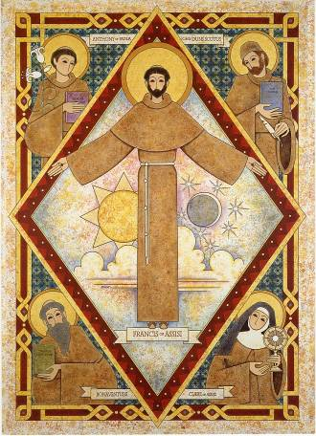
Would you believe/welcome an intellectual tradition that:
1. Addresses the deepest concerns that tear at the heart of humanity today?
2. Confirms the inviolable dignity and inalienable rights of the human person no matter what spiritual or cultural household?
3. Gives Franciscan vision of what it means to be human?
Custodians of the Tradition
2

Slide 3
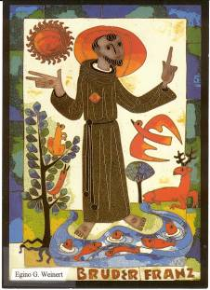
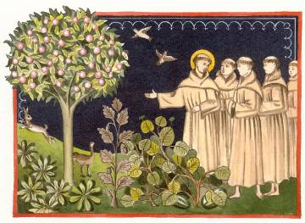
Would you believe/welcome an intellectual tradition that:
4. Experiences creation with awe and reverence acknowledging that each creature expresses something of God that can be expressed by no other?
5. Creates no other possibility but to be “ecologically literate” in the healing of the earth?

Slide 4
This course is designed to offer AFCU Faculty an opportunity to learn some foundational information about the Franciscan Intellectual Tradition and how to incorporate that tradition into courses that they teach. Participants will learn what the FIT is and gain an understanding of resources that offer them and their students a better understanding of the tradition.
4

Slide 5
Learning Outcomes
The faculty member will be able to:
articulate the key elements of the Franciscan Intellectual Tradition;
locate and utilize resources in the Franciscan Intellectual Tradition;
identify options for including the Franciscan Intellectual Tradition in a specific course that they teach;
access, share, and collaborate on Franciscan Teaching Resources.
5

Slide 6
Course Outline
The course is organized into the following modules.
Module I: Saint Francis: A Brief Look into His Life (Slides 8-43)
Module II: Development of the Franciscan Intellectual Tradition (Slides 44-86)
Module III: Saint Francis as a Student and Teacher (Slides 87-103)
Module IV: Francis as a “Vernacular Theologian” (Slides 104-127)
Module V: Sample Courses Utilizing the FIT (Slides 128-143)
Module VI: Developing Learning Activities (Slides 144-177)
6

Slide 7
Working Through the Course
You should be able to complete each module in about a week’s time within your normal workload. Of course, you may choose to accelerate this pace or take more time with each module, depending on your particular needs and interests.
There are reflection questions interspersed through the course. You may find it helpful to keep a journal of reflections to guide your application of the FIT to your courses.
You might also find it helpful to keep a record or chart of connections you see between the FIT and what you are already teaching.
There are links to other resources that will require an internet connection.
You may work through the material in any way you see fit, but the presentation is designed to promote reflection. We recommend you view the presentation in Slide Show mode and click to advance individual slides. Animations are set to occur automatically on each slide to emphasize individual points and encourage engagement with the material.
If you have questions about the course while working through the material, you can email them to afcu@felician.edu.
7

Slide 8
St. Francis
A Brief Introduction to His Life
8

Slide 9
Potential Problems in Learning about Francis
The “Franciscan Question” — any attempts to reconstruct a life of Francis are necessarily interpretations. Our questions and interests shape how we see Francis.
He was a Catholic saint, so finding the “true” Francis requires digging behind the hagiographies of his time, and of ours.
As a saint, he can seem so holy that he is impossible to imitate.
Source: Augustine Thompson, Francis of Assisi, A New Biography
9

Slide 10
Potential Problems in Learning about Francis (continued)
There is always a temptation to use Francis as a mouthpiece for our own ideas. We often try to domesticate him for our own purposes.
An in-depth investigation into Francis can make us uncomfortable, as there is much about him that is deeply challenging to the lives we live.
10

Slide 11
Early Life
Born in winter of 1181/1182 to Pietro and Pica Bernardone, in Assisi. Mother named him Giovanni (John), but Pietro named him Francesco (“Frenchy”).
Received a basic education and became fluent in French.
Note: This timeline follows the one detailed by Augustine Thompson in Francis of Assisi, A New Biography
11

Slide 12
Early Life
Around age of fourteen began to work in father’s cloth business.
Known for friendliness, generosity, and charisma with friends, as well as his enjoyment of partying.
12

Slide 13
Francis the (failed) warrior
In November of 1202, Francis joins the war between the cities of Assisi and Perugia.
Captured in the battle at Collestrada.
Held as prisoner of war in Perugia for a year, until father ransoms him.
Comes back a changed man, slightly withdrawn from his former life.
13

Slide 14
War again?
In spring 1205, he prepares to go back to war in southern Italy.
Gets to Spoleto, has a mystical dream from God, abandons trip to the war, sells his war gear, and returns on foot to Assisi.
14

Slide 15
Beginnings of a new life (1205)
On way back to Assisi he stops at San Damiano church, a run-down church outside of Assisi.
Francis spends the night there and leaves the money from the sale of his horse and armor on one of the windows of the church.
Continues to withdraw from life in Assisi. Begins to engage in frequent almsgiving.
15

Slide 16
New beginnings
Makes a pilgrimage to Rome and continues almsgiving there.
Begins to visit San Damiano frequently, praying before the crucifix.
16

Slide 17
Confrontation and Renunciation (1206)
His family becomes worried about Francis’s increasingly erratic behavior and goes looking for him, but Francis hides from them.
Finally, Francis returns to Assisi, where he is met with scorn by its citizens and where his father asks the bishop to intervene
In a public confrontation with his father and in the presence of the local bishop and the citizens of Assisi, Francis strips off his clothes, gives them to his father, renounces his inheritance, and declares that his only Father will be his Father in heaven.
17

Slide 18
Conversion
Naked and poor, Francis wanders in the snow around Assisi until he settles with some lepers outside of Assisi and begins to care for them.
Francis locates his time with the lepers as the beginning of his conversion.
18

Slide 19
Quiet years – 1206-1208
Francis spends the next two-three years as a penitent.
Lives and works among the lepers.
Repairs the church at San Damiano.
19

Slide 20
First Brothers
In the spring of 1208, Bernard of Quintavalle approaches Francis about joining him.
Wealthy Bernard sells his possessions and begins to follow Francis, along with another man, Peter.
Francis and his new followers consult an altar missal and randomly find three verses that shape Francis’s understanding of his incipient brotherhood.
20

Slide 21
Biblical Basis of Brotherhood
Mark 10:21 — “Jesus, looking at him, loved him and said, “You lack one thing; go, sell what you own, and give the money to the poor, and you will have treasure in heaven; then come, follow me.”
Luke 9:3 — “He said to them, “Take nothing for your journey, no staff, nor bag, nor bread, nor money—not even an extra tunic.”
Matthew 16:24 — “Then Jesus told his disciples, “If any want to become my followers, let them deny themselves and take up their cross and follow me.”
These verses are the foundation of what will become in a more fully developed way the Franciscan rule of life.
21

Slide 22
Initial Approval
Francis and his followers travel to Rome to get initial approval for their way of life.
In an audience with Pope Innocent III, he gives them provisionary approval to continue and commissions them to preach penance.
Francis and his followers receive the tonsure and return to Assisi, settling initially in an abandoned shed in Rivo Torto, about two miles from Assisi and close to the leprosarium of San Lazzaro.
New recruits begin to join and Francis re-settles the group at a ruined chapel, Santa Maria deli Angeli in the Portiuncula.
22

Slide 23
Early Expansion
Brothers begin to wander throughout Italy, working, begging, worshipping, and occasionally preaching.
Content of their preaching was repentance, moral reform, peace and reconciliation.
Francis begins to develop a reputation throughout Italy as an especially holy person, adept at spiritual direction.
Francis attempts to travel to the Holy Land to preach, but bad weather forces him back to Italy.
23

Slide 24
Clare of Assisi
In 1212, Brother Rufino, a cousin of Clare of Assisi, approaches Francis to tell him that Clare wanted to meet him.
Only 18 at the time, Clare came from a wealthy Assisi family.
After several chaperoned clandestine meetings Clare escapes her family enclave on Palm Sunday 1212 and meets Francis and his brothers at the Portiuncula.
24

Slide 25
First Convent, Second Order
Clare stays with the Benedictines during Holy Week and later with a beguinage community before taking up permanent residence at San Damiano, which became the first Franciscan convent.
Francis gives her a form of life similar to what the brothers followed. Clare would not get a formal rule approved for her order until the end of her life.
25

Slide 26
La Verna
In May 1213, Francis receives a gift of land on Mount La Verna, which he will use as a spiritual retreat for the rest of his life.
26

Slide 27
Fourth Lateran Council
In 1215, Pope Innocent III convened the Fourth Lateran Council, which Francis may have attended.
Calls for religious orders to meet regularly as “chapters”. (#12)
Allows for bishops to appoint persons to preach and take confession, tasks which Franciscans will begin to enact. (#10)
Forbids the formation of new religious orders, though the Franciscans seem to have been exempt from this requirement, perhaps because of their prior approval. (#13)
http://www.papalencyclicals.net/Councils/ecum12-2.htm
27

Slide 28
Mission Work
By 1217, there were probably fewer than 800 Franciscan brothers.
Brothers begin mission work throughout Europe, without much initial success.
In his travels, Francis meets Cardinal Hugolino of Ostia, who would have a major influence on the Franciscans as Cardinal and later as Pope Gregory IX.
28

Slide 29
Francis and the Sultan
In June 1218, the Fifth Crusade lays siege to Damietta.
In fall 1219, Francis arrives at Damietta with some companions.
Francis crosses enemy lines and preaches to the Muslim Sultan, Malik al-Kamil.
While conversion to each other’s religion is not the focus, a mutual respect develops. Francis’s courage attracts several priests who are at the siege, who join his movement.
Receiving word of problems in the Order in Italy, Francis returns home.
29

Slide 30
1220-1221
Faced with brothers trying to change the order away from Francis’s original vision, Francis asks Pope Honorius III for assistance.
Honorius appoints Cardinal Hugolino as protector of the order.
Honorius exerts authority on behalf of Francis, so that Francis can maintain his emphasis on minority.
30

Slide 31
Revisions of life
Honorius writes a letter, Pro Dilectis Filiis, on behalf of the brothers, asking prelates to allow the brothers to preach without opposition.
New members must now complete a year-long novitiate.
Francis begins work on a new version of his rule of life.
31

Slide 32
A Second Stripping
In the fall of 1220, Francis relinquishes all leadership responsibilities for the Order, turning the reins over to Brother Peter of Cataneo.
Francis asks for a novice to be in charge of him, someone he must obey.
32

Slide 33
Sickness and withdrawal
In the meantime, Francis struggles with what is probably malaria, which he had contracted on his trip to Egypt.
Francis begins to withdraw from the Order, spending more time in solitude.
Brother Peter dies after six months and Brother Elias takes over as administrator for the Order.
33

Slide 34
New Rule
In November 1223, the final form of Francis’s life, “The Later Rule”, would be approved by Pope Honorius III. It remains the primary organizing document for Franciscan life today.
Elements:
Living the Gospel in obedience, without possessions, and in chastity.
Brothers are exhorted to “be meek, peaceful, modest, gentle, and humble, speaking courteously to everyone.”
Brothers are forbidden from receiving money, but they are called to work so as to avoid idleness.
Brothers are to care for each other as family members, and confess their sins. Fraternal correction is urged to be undertaken with charity and goal of spiritual growth.
Brothers may only preach with permission from local prelates of ministers of the Order.
34

Slide 35
Christmas
In December 1223, Francis leaves Rieti to visit Greccio for Christmas.
Francis reenacts a live Christmas crèche created near the local church’s altar.
Francis appreciated the humility of the Incarnation, but also saw the manger scene, with its animals, as pointing to how all of creation participates in Christmas.
In failing health, Francis stays in a hermitage in Greccio through the following spring.
35

Slide 36
Mount La Verna
By Summer 1224, Francis is well enough to travel to Mount La Verna, where he lives in his mountain hermitage.
Finds himself engaged in spiritual combat with demonic forces.
Francis has vision of a six-winged seraph (angel).
36

Slide 37
Stigmata
After the vision, Francis begins to manifest the stigmata — fleshly protuberances on his palms and feet in the shape of nails, and a suppurating wound on his side.
Out of humility, Francis hides these marks from all but his closest confreres for the rest of his life, though there were many eyewitnesses to them after his death.
37

Slide 38
Return to Assisi
In fall 1224, in even worse health, Francis leaves La Verna and returns to a hut attached to San Damiano.
He writes the first verses of “The Canticle of the Creatures” in the midst of his ill health and a severe eye disease. It is a poetic expression of praise for God in the midst of suffering.
In June 1225, he heads back to Rieti for medical treatment.
38

Slide 39
Progressively worse
In Rieti, Francis refuses medical treatment (he was a very difficult patient).
Finally, Brother Elias has to command Francis under his oath of obedience to receive care.
His eye disease is treated by cauterizing his eye with a red hot iron poker. It did not improve his situation.
39

Slide 40
Last Days
In spite of his ill health, visitors come to him for various healing miracles, prayer, and care.
Francis is moved to Siena, then Celle, and then finally back to Assisi in July 1226. He stays at a newly constructed Franciscan house at Begnara.
Doctors tell him he is dying and give him just a few months to live.
40

Slide 41
Death
In September 1226, Francis asks to be taken to the Portiuncula, one of the original locations of his Order.
On his death bed, Francis is surrounded by brothers and priests, but rarely receives outside visitors.
Francis dies on October 3, 1226.
41

Slide 42
Sainthood
His body is carried to Assisi, with a stop by San Damiano, where Clare and her sisters pay their last respects.
His body remained at the church of San Giorgio for four years, until a basilica was built and his body was permanently interred.
Cardinal Hugolino is elected pope in March 1227 and as Gregory IX makes Francis a saint in July 1228.
Webcam of St. Francis's Crypt
42

Slide 43
For Further Reading
Francis of Assisi: The Life, by Augustine Thompson, O.P.
Francis of Assisi: The Life and Afterlife of Medieval Saint, by André Vauchez
Francis & His Brothers: A Popular History of the Franciscan Friars, by Dominic V. Monti, O.F.M.
43

Slide 44
Development of the Franciscan Intellectual Tradition (FIT)
Franciscan Movement of Co-Founders Francis and Clare
Retrieval of the Franciscan Intellectual Tradition
Some key contributors of the FIT
Some key components of the FIT and some "Contemporary Perspectives" on Franciscan Education
Notes:
Narrative: each of these four is a module ending with a reflection

Slide 45
Franciscan Educational Approaches
Franciscans in the thick of life’s problems as well as in academic circles to address issues, e.g. Oxford, Paris, Cambridge and Cologne
Franciscans stepped back to reflect and analyze patterns within a distinctive theological perspective
Franciscans exercise freedom and resources to facilitate scientific experimentation
Franciscans intend to make learning practical and to ever improve daily living
FIT invested today at 24 colleges and universities in United States (AFCU members)

Slide 46
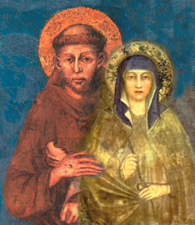
I. Franciscan Movement Co-Founders Francis and Clare
Notes:
For more on this topic resource the AFCU “Charism” module 1 found on their website.
“In one way the Franciscan intellectual tradition began in the late 1230s. The Franciscans first gathered in 1209, in the Umbrian commune of Assisi. They spread rapidly and were in Paris by the early 1220s, on the outskirts of the city. From there they soon moved into the city, close to where the learning was going on. A well-known and ecclesiastically busy English churchman and theologian in Paris, Alexander of Hales, started teaching in the Franciscan house in Paris and ended up becoming a friar himself. That was in 1236. Alexander, in his early 50s, was a magister regens. A professor with
tenure, let us say. He held onto the position as a friar and, as the rules allowed, passed his chair to a fellow friar. So the Franciscans ended up with a chair of theology of their own. One of Alexander’s early students was Bonaventure of Bagnoregio. ” It’s the tradition, it’s our héritage.
David Flood, O.F.M.
Montreal, October 2, 2007.

Slide 47
A Franciscan Movement
Francis
Architect
Vernacular theologian
Poet and Song writer
Reverence for environment
Clare
Gardener and image maker
Incarnational Leader
Mentor and model
Formator in contemplative prayer
“and the Lord, God, gave me brothers…”
Shaped by the examples of Clare and Francis
Grounded in the gospels, i.e. evangelical form of life
Tradition took root in the great medieval universities
Distinct but not static perspective
Notes:
As significant as St Francis was, he and Clare formed a synoptic expression. Hence, it was a Franciscan movement not limited to the experience of Francis and Clare. Their worldview, theology and spirituality attracted many from all aspects of life to shape the culture.

Slide 48
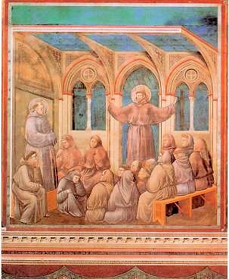
Francis’s Letter to Brother Anthony
I Brother Francis send wishes of health to Brother Anthony, my bishop. It pleases me that you teach sacred theology to the brothers, as long as in the words of the Rule you "do not extinguish the Spirit of prayer and devotion" with study of this kind.
Anthony preaching to the brothers
Notes:
48
Anthony entered the Franciscans after being an Augustinian. He was asked by the friars to teach them but wouldn’t do it until given permission by Francis. Our very tradition nods from Francis himself to learning and an intellectual tradition.

Slide 49
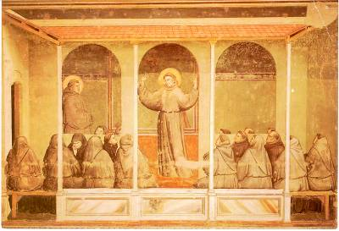
Franciscan Intellectual Tradition
A set of values, theologically informed,
that comprise a distinct view of the world,
one that takes as its basis the theological intuitions of Francis of Assisi
Notes:
Three points that are distinctive to the Franciscan tradition that differ in interpretation to the Dominican view
Mystery of God as generous love
Humanity of Christ
Sense of creation as family -Zachary Hayes OFM
The theological intuitions of Francis give rise to a distinctive worldview.
Goodness and Humility of God
Primacy of Christ
Dignity of human person

Slide 50
Historical Rediscovery Part I: Historically accurate portrait of Francis
Francis wrote at least twenty-eight documents and dictated five others
passionate love for Jesus Christ and the desire to follow him
contemplative prayer
ongoing conversion of life
spirituality of fraternitas with everyone and everything as sister/brother
Inspired by itinerancy of Jesus
devotion to the Incarnation
love of the Gospel and Eucharist
spiritual vision of the human family
public preaching of God’s love and peace
practice of deeply listening to the Gospel
receiving the Eucharist
weaving periods of contemplative prayer in wilderness hermitages with public proclamation of God’s love in the vernacular language

Slide 51
Historical Rediscovery Part I: Historically accurate portrait of Clare
Born into a noble family dominated by women
Clare joins Francis and the brothers at Portiuncola
Clare is enclosed at San Damiano; accepts the duties of abbess
Clare thwarts off the invading Saracens to save San Damiano Convent and the city of Assisi
Records of multiple healings
Described as Co-Founder of Franciscan movement more than Francis’ “little plant”
Spirituality
Incarnational leadership as sister
Contemplative prayer: gaze, consider, contemplate as desire to imitate
Grounded in Eucharist
Lived poverty daily
Writings
Five letters (4 to Agnes of Prague)
Request for the Privilege of Poverty
Testament
Approved Rule (Form of Life)written by Clare (Ch VI Francis piece)

Slide 52
The Franciscan Intellectual Tradition
rooted in Gospels
reflected in Book of Scripture and “Book of Nature”
praxis for love, virtue, and moral living
articulates a vision for living, loving, and knowing into the future
Notes:
Bonaventure explained that one can learn about Christ through sacred Scripture but also by “reading” the “Book of Nature”

Slide 53
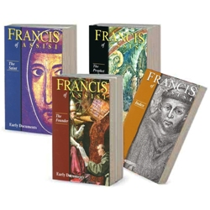
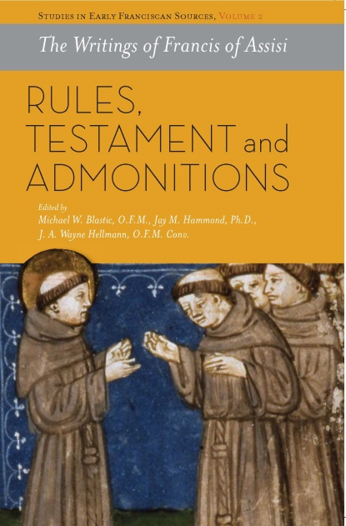
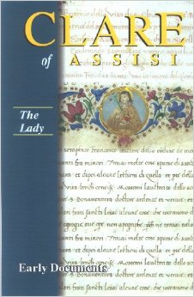
II. RETRIEVAL of the Franciscan Intellectual Tradition
Notes:
Critical editions of the writings of Francis and Clare and commentaries made available in English in the year 2000 led to greater understanding of the FIT.

Slide 54
Overcoming History
1879 | 1917 | 1966 | 1993
Leo XIII in Aeterni Patris gives “pride of place” to Thomism | Code of Canon Law revised | Ecclesial nod!
- “spread the teachings of Thomas far and wide for the defense and beauty of the Catholic faith, for the good of society and the advantage of all the sciences” -“those who assail it will always be suspected of error” -bound by statutes of Benedictines, Carmelites, Augustinians, Jesuits | - Explicit affirmation of methods, teaching, and principles of the Angelic Doctor - Thomism is the carrier of Catholic Orthodoxy - Franciscans trained as Thomists | Paul VI Apostolic Letter – Alma Parens “Scotus develops to its full height the Gospel truth which St. John the Evangelist and St. Paul understood to be pre-eminent in the divine plan of salvation” | Beatification of John Duns Scotus Pope John Paul II “The teachings of Scotus energetically builds up the church, sustaining her in her urgent mission of the new evangelization of the people of the earth”
Notes:
Leo XIII in Aeterni Patris gives “pride of place” to Thomism: “the special bulwark and glory of the Catholic faith.”

Slide 55
Commission on the Franciscan Intellectual Tradition Retrieval (2001!)
“Our purpose in retrieving and revitalizing the tradition is thus subordinate to our mission to give people hope, speak to their fears, and present a coherent intellectual pathway which strengthens faith and encourages just action for our neighbors.”
understand the beauty and the wealth of our intellectual tradition
help the Church see this tradition as valid and meaningful for today’s society
look seriously at the preeminence of charity, and the use of charity in our teaching of theology to those who have difficulty in belief…focus on the ecumenical ramifications of this primacy of charity
look seriously again at the primacy of Christ and the motives of the Incarnation
Notes:
John Paul II reminded us to be faithful to the tradition of our Order, to the intellectual formation which must be regarded as a fundamental requirement for evangelization. See Franciscantradition.org
“In March 2001, the English-speaking Conference (ESC), Order of Friars Minor (OFM), undertook an initiative for the contemporary retrieval of the Franciscan Tradition. The commission on the Franciscan Intellectual Tradition (CFIT) is the result of that initiative. It is composed of the Franciscan leaders from the English speaking provinces of the Order.”

Slide 56
Retrieval Part II: Re-examination of Franciscan Tradition
Since 1993, the focus of Franciscan scholarship has expanded to
investigate how Francis’s religious intuition has shaped the practice of Franciscan
spirituality as a broad tradition in diverse expressions: in living, prayer, preaching,
thinking, and acting for the past eight centuries across the world
open up fresh perspectives on how to live out the Franciscan stance today
most surprising rediscovery—was the recognition of a distinctly Franciscan approach to philosophy, theology, and now, more broadly, to the intellectual life
Identifying distinctive Order/sponsor particularity

Slide 57
Retrieval Part III: Encouraging application in institutions/classroom
FIT might seem counterintuitive to popular “poor man from Assisi”
creative continuity through institutionalization rather than the purity of Francis’s primitive vision corrupted by academic institutions
purpose is not merely to mimic Francis
FIT is a philosophical and theological expression of the Catholic faith
FIT complements the other two major intellectual traditions within western Catholicism, the Augustinian and Thomistic (or Dominican)
All three respect the fundamental teachings of Scripture, tradition, and magisterium.
All three traditions have received the blessings of popes and scholars
All reinforce each other on the essential elements of the one Catholic faith yet in their diverse interpretive approaches, they complement each other
Notes:
Revealing Franciscan Distinction
See Volume One of the The Franciscan Heritage Series, authored by Kenan B. Osborne, OFM published in 2003 by CFIT.

Slide 58
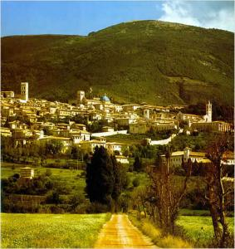
Reflection
How can you continue the retrieval by incorporating the FIT into your classes?

Slide 59
III. KEY CONTRIBUTORS
Those like ourselves who are immediate heirs of the tradition
inspired by the spirituality of Francis [and Clare] might better see ourselves
as responsible stewards of a treasure that has much to offer for the healing
of humanity and of the world at large.
Zachary Hayes O.F.M.
Bonaventure Fest, 2003, Aston, PA
Notes:
See the Custodians of the Tradition: Reclaiming the Franciscan Intellectual Tradition found on the cfit website, http://franciscantradition.org/resources/custodians

Slide 60
Primary Franciscan Contributors
Anthony of Padua 1195-1231 Teacher of the Gospels, preacher
Bonaventure of Bagnoregio 1217-1274 Teacher, commentaries of Scripture emphasis on “literal” vs “allegorical” sense, meaning of history (Collations on Hexameron)
Roger Bacon 1214-1294 Teacher, studies optics, light, philosopher for emphasis on empirical methods, sciences as preparation for theology, credited as one of the earliest European advocates of the modern scientific method
John Duns Scotus 1266-1308 Philosopher and theologian left a mark on the nature of human freedom and dignity of human person: “haecceitas”
William of Ockham 1288-1348 Teacher contributes principle of economy known as “Ockham's Razor” (do not multiply entities without necessity)
Haymo of Faversham 1175-1244 Teacher, Master of Divinity
Alexander of Hales 1185-1245 Teacher, exceptional lecturer, author of Summa Theologiae
John Peckham 1225-1292 Poet, philosopher, and theologian, Archbishop of Canterbury debated T. Aquinas
Peter John Olivi 1248-1298 Commentaries on Scripture, on Franciscan way of life, on poverty of Christ
Angela of Foligno 1248-1309 Teacher of Theologians, Mystic

Slide 61
Secondary Franciscan Contributors
Bartholomew de Glanville 1220-1240 encyclopedist writing a 19-volume encyclopedia On the Properties of Things and was the first to make readily available the views of Greek, Jewish, and Arabic scholars on medical and scientific subjects
Bernardine of Siena 1380-1444 Business and banking, “economy of gift”, notion of “just profit” founder of pawnshops for the poor
Luca Pacioli 1445-1517 Mathematician documents and spreads double entry bookkeeping system of debits and credits to organize finances and break out of cycle of poverty
Bernardino de Sahagún 1499-1590 New world missionary and anthropologist compiled information about Aztec religion and culture and of the Historia general de las cosas de Nueva España , regarded as being one of the "fathers of ethnography" and creator of the first encyclopedia of the new world
Ramon Lull 1232-1315 Linguist and founder of School of Languages, encyclopedic work
Bernardino de Laredo 1492-1540 Pharmacist, physician
Vincenzo Coronelli 1650-1718 Cosmographer , Engineer provides first description of known world
Laurent Receveur 1757-1788 Geologist , Botanist travels three years around the globe collecting specimens
Notes:
Breadth of Franciscan Influence in Applied Sciences:
Astronomy
Architecture
Art
Business and Banking
Chemistry
Economics
Geography
Geometry
Literature
Pharmacology
Physics
Mysticism
Philosophy
Theology

Slide 62
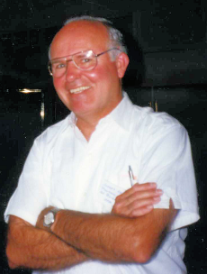
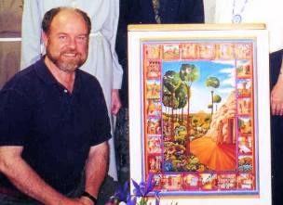
Contemporary Franciscan Contributors
Joe Chinnici, OFM
The vital time for the recovery of our Franciscan intellectual tradition in its compatibility with elements of
postmodern thought
affinity for science
valuation of creation
focus on freedom and the person
Bill Short OFM
Serious work on the interface of ecology, creation & nature
Involvement in the disciplines of economics, technology, politics, cosmology, etc, so as to take the Incarnation in its demands on our intellectual reflection seriously.
Notes:
Br. William Short, OFM serves on the task force for the English Speaking Conference which committed itself to presenting to the large Franciscan family its intellectual traditions. He is Dean of the Franciscan School of Theology, Professor of Christian Spirituality and Core Doctoral Faculty Member
Joseph P. Chinnici, OFM, Professor of Church History, Franciscan School of Theology, Graduate Theological Union, Berkeley, California President and Professor of History Core Doctoral Faculty Member. Chinnici analyzed the church’s relationship to our age and culture and the ways in which leaders misused their power to shore up an institutional vision that ultimately has little to do with the essence of Christianity. Father Chinnici has published a book,When Values Collide, which blends his own personal experience of trying to do the right thing in a fraught atmosphere, the best social-scientific and psychological research, and serious reflection by a follower of St. Francis on the way the church’s leaders can re-establish confidence and trust.

Slide 63
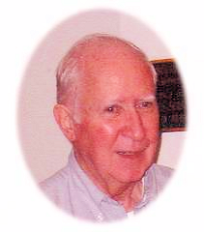
Contemporary Franciscan Contributors
Ilia Delio
For the intellectual mind can never behold the depth of God. Only the heart can enter into the incomprehensible mystery of divine love.The Humility of God: A Franciscan Perspective
The Good News of Jesus Christ, as the Franciscans understood it, is that we do not “go to God” as if God sat in the starry heavens awaiting our arrival; rather, God has “come to us” in the Incarnation. “The eternal God has humbly bent down,” Bonaventure wrote, “and lifted the dust of our nature into unity with his own person.” We move toward God because God has first moved toward us—this is the Franciscan path of prayer. Franciscan Prayer
Zachary Hayes
Those like ourselves who are the immediate heirs of the tradition inspired by the spirituality of Francis might better see ourselves as responsible stewards of a treasure that has much to offer for the healing of humanity and of the world at large.”.
Notes:
Ilia Delio, OSF is a Senior Fellow at Woodstock Theological Center, Georgetown University, where she concentrates in the area of Science and Religion. She is currently involved in research projects on transhumanism, technology and evolution, and ecology and education. She is also exploring the theology of Pierre Teilhard de Chardin. Ilia is the author of ten books including, The Humility of God, Christ in Evolution, and Care for Creation, which won two Catholic Press Book Awards in 2009. Her new book, The Emergent Christ: Exploring the Meaning of Catholic in an Evolutionary Universe. She imagines the trajectory of cosmic history in the direction of greater cooperation, complexity, and convergence—including the role of technology in this process.
Zachary Hayes, OFM is one of the most renowned American scholars of the theology of St. Bonaventure in the twentieth century. Fr. Hayes was regarded as a preeminent interpreter of the works of St. Bonaventure, as well as a scholar of creation-theology and eschatology. Among his most notable works are The Hidden Center: Spirituality and Speculative Christology in St. Bonaventure, his translation of then-Cardinal Ratzinger’s The Theology of History in Bonaventure, and Bonaventure: Mystical Writings. In 2002, he was honored with the Franciscan Institute Medal from St. Bonaventure University.

Slide 64
Reflection
How can you encourage your students and colleagues to be responsible stewards and live the Franciscan virtue of poverty in your class?
Notes:
You can always copy two sided to save paper.
You can shut off the lights when you are not in your classroom or office.
You can re-cycle paper and use it for calculations
You can allow students to use ebook versions of any classic books on-line.

Slide 65
IV. SOME KEY FIT COMPONENTS and "Contemporary Perspectives" on Franciscan Education
http://franciscancollegesuniversities.org/
Franciscantradition.org
The Franciscan Intellectual Tradition

Slide 66
What are the key distinctive components of FIT we will consider?
Communion of Trinity
God as Bonum/Goodness
Christology
Primacy of Christ
Love, Passion of God
Humility/Humanity
Incarnation
Canticle of the Sun
Sense of creation as family
Dignity of the Human Person
haecceitas: particularity
minores: role of the human person not over but under and with
Ethics, Moral Vision as “responding to God’s love”
Development of a moral integrity

Slide 67
Communion of Trinity Mystery of God as Love
God is relational; goodness, love expressed outwardly
Communion of Persons
Plenitudo: fullness
Fontalis: source of water
Fountain-fulness expressed outwardly
Father sends, gives life
Son, Word, “Beloved”
Spirit as “Co-Beloved”
Image of God: expressing goodness in relationship with others
Christ sent from this God (as beginning, center, end)
Reveals we are image of God
All creation image of good God
Home, future is in good God
Relational, optimistic
Notes:
For more on this topic resource the AFCU “Community” module 3 found on their website.

Slide 68
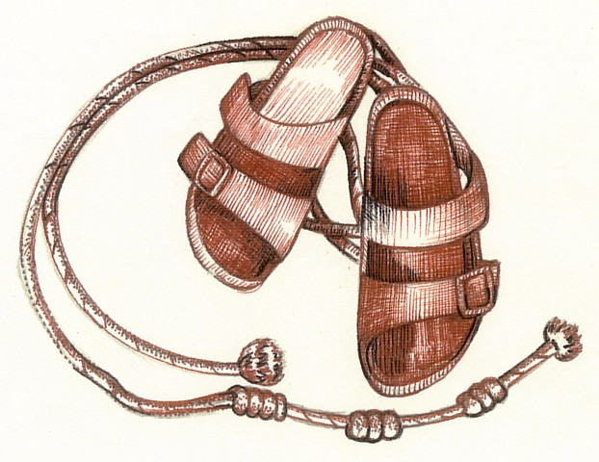
Reflection
In what ways can I get my students and colleagues to be thankful for all that we have and to be committed to passing on good to others, and in particular those in need?
Notes:
To support food drives
Get class involved in service learning to help others
Have clubs involved in fund raising give a percentage of their fund raising to a cause.

Slide 69
God as Good:
In the Franciscan Intellectual Tradition, a relational Triune God is consistently seen as the basis for God's own nature, which is love and goodness. The medieval axiom: bonum est sui diffusivum ("goodness is diffusive of its very self") lies at the heart of Franciscan theological discussion on God. (Osborne)
“Peace and Good” (Pax et Bonum or Pace e Bene) was the greeting Francis used, but more than that it is a description of being with God. (Short)
Notes:
The time and historical setting of Francis and Clare, thirteenth century Assisi, was a period of great violence, poverty, and corruption. There was significant political and cultural unrest with extreme brutality and bloodshed a daily reality in the form of the crusades and the wars among the Italian city-states. The class structure of Assisi was very much divided among the "majores“ (nobles), "minores“, and serfs. Francis’s family was part of the new relative middle class of wealthy merchants. This social class division and inequality left most in despair with little hope or chance of improving their lot in life. There were both allegorical and literal walls that separated the people. Anyone diagnosed with leprosy or similar afflictions were provided a funeral ceremony and banished to outside the city walls. The region's transition to a new money-based economy brought with it an increased emphasis on material wealth and profits while the Church was losing its moral authority via various forms of corruption. In stark contrast, Francis always sought to see the good in everything because, as found in the Genesis account, “goodness” is the primary attribute of God. He sought to remedy evil, not by attacking, criticizing, or accusing, but by humbly doing good and modeling the life of Jesus as closely as possible.
The time and historical setting of Francis and Clare, thirteenth century Assisi, was a period of great violence, poverty, and corruption. There was significant political and cultural unrest with extreme brutality and bloodshed a daily reality in the form of the crusades and the wars among the Italian city-states. In stark contrast, Francis always sought to see the good in everything because, as found in the Genesis account, “goodness” is the primary attribute of God.
“ Let us refer all good to the Lord God Almighty and Most High, acknowledge that every good is His and thank Him, from Whom all good comes, for everything.” - “The Earlier Rule” – St. Francis of Assisi
In the Franciscan Intellectual Tradition, a relational Triune God is consistently seen as the basis for God's own nature, which is love and goodness. The medieval axiom: bonum est sui diffusivum ("goodness is diffusive of its very self") lies at the heart of Franciscan theological discussion on God. (Osborne)
Francis’ vision reached from the loving Creator to the richness and beauty of the gift which pours forth in the work of creation. The Franciscan understanding of the meaning of poverty is rooted here. For Bonaventure, in fact, the meaning of poverty lies basically in recognizing that all things in the created universe, myself included, come as a pure gift from the loving, creative power of God. Our first response to such giftedness is awe and gratitude, not a search for
possession and control. And our ongoing challenge is to discover how one most appropriately receives and lives with and in such giftedness. Because for both Bonaventure and Scotus God is the mystery of a self-diffusive kind of overflowing love that is beyond measure, it is not surprising to them that there should be such a rich variety of created “words” through which the eternal mystery of Love finds expression in creation. By analogy, then, creation is like the Creator in terms of divine simplicity and boundless fertility. Although the elements of the
created order are few and simple, they come together to produce a staggering richness of both non-living and living forms. According to Bonaventure, the deepest truth about the created world is that it has within itself the potential to become, through God’s grace, something of what has
already come to be in the mystery of Christ: like Christ, creation can receive and respond to the self-communication of the mystery of divine love. Moreover, what has happened between God and the world in Christ points to the future of the cosmos, a future that involves the radical transformation of created reality through the unitive power of God’s creative love.

Slide 70
God as Good:
Francis
“Let us refer all good to the Lord God Almighty and Most High, acknowledge that every good is His and thank Him, from Whom all good comes, for everything.” - The Earlier Rule
“You are Good, all Good, supreme Good…” The Praises of God
Clare
Clare demonstrate a similar understanding of God as she expressed in some of her last words, “Go calmly in peace, for you will have a good escort, because He who created you has sent you the Holy Spirit and has always guarded you as a mother does her child who loves her. O Lord, may You Who have created me, be blessed.”
Bonaventure
“For Bonaventure, the creative and sustaining principle of all created reality is a mystery of orderly love, not of arbitrariness or domination or control. Such an understanding views power as the ability to call forth through love the good in the other. If this is so, we are invited to shape our relationships with all of created reality in a familial way, grounded as we are together in the mystery of God’s creative love.” (Hayes)
Notes:
The time and historical setting of Francis and Clare, thirteenth century Assisi, was a period of great violence, poverty, and corruption. There was significant political and cultural unrest with extreme brutality and bloodshed a daily reality in the form of the crusades and the wars among the Italian city-states. The class structure of Assisi was very much divided among the "majores“ (nobles), "minores“, and serfs. Francis’s family was part of the new relative middle class of wealthy merchants. This social class division and inequality left most in despair with little hope or chance of improving their lot in life. There were both allegorical and literal walls that separated the people. Anyone diagnosed with leprosy or similar afflictions were provided a funeral ceremony and banished to outside the city walls. The region's transition to a new money-based economy brought with it an increased emphasis on material wealth and profits while the Church was losing its moral authority via various forms of corruption. In stark contrast, Francis always sought to see the good in everything because, as found in the Genesis account, “goodness” is the primary attribute of God. He sought to remedy evil, not by attacking, criticizing, or accusing, but by humbly doing good and modeling the life of Jesus as closely as possible.
The time and historical setting of Francis and Clare, thirteenth century Assisi, was a period of great violence, poverty, and corruption. There was significant political and cultural unrest with extreme brutality and bloodshed a daily reality in the form of the crusades and the wars among the Italian city-states. In stark contrast, Francis always sought to see the good in everything because, as found in the Genesis account, “goodness” is the primary attribute of God.
“ Let us refer all good to the Lord God Almighty and Most High, acknowledge that every good is His and thank Him, from Whom all good comes, for everything.” - “The Earlier Rule” – St. Francis of Assisi
In the Franciscan Intellectual Tradition, a relational Triune God is consistently seen as the basis for God's own nature, which is love and goodness. The medieval axiom: bonum est sui diffusivum ("goodness is diffusive of its very self") lies at the heart of Franciscan theological discussion on God. (Osborne)
Francis’ vision reached from the loving Creator to the richness and beauty of the gift which pours forth in the work of creation. The Franciscan understanding of the meaning of poverty is rooted here. For Bonaventure, in fact, the meaning of poverty lies basically in recognizing that all things in the created universe, myself included, come as a pure gift from the loving, creative power of God. Our first response to such giftedness is awe and gratitude, not a search for
possession and control. And our ongoing challenge is to discover how one most appropriately receives and lives with and in such giftedness. Because for both Bonaventure and Scotus God is the mystery of a self-diffusive kind of overflowing love that is beyond measure, it is not surprising to them that there should be such a rich variety of created “words” through which the eternal mystery of Love finds expression in creation. By analogy, then, creation is like the Creator in terms of divine simplicity and boundless fertility. Although the elements of the
created order are few and simple, they come together to produce a staggering richness of both non-living and living forms. According to Bonaventure, the deepest truth about the created world is that it has within itself the potential to become, through God’s grace, something of what has
already come to be in the mystery of Christ: like Christ, creation can receive and respond to the self-communication of the mystery of divine love. Moreover, what has happened between God and the world in Christ points to the future of the cosmos, a future that involves the radical transformation of created reality through the unitive power of God’s creative love.

Slide 71
Christology Primacy of Christ
Christ is the beginning
Alpha
Christ is the end
Omega
Christ is the center
Middle (sent from Trinity)
Knowing Christ gives glimpse of something more, God
Beginning of knowledge of God and ourselves
Encounter through words of the Gospel
Word takes flesh in our lives
Notes:
See Zachary Hayes, “Christ, Word of God and Exemplar of Humanity” in the Custodians from CFIT.

Slide 72
Christ as the Center
Christ is alpha (original) of all creation
the origin of all things (Prologue of John’s Gospel)
the Wisdom of God
the Love of God, incarnate, crucified (Bonaventure)
Primacy of Christ, before all else
Omega (fulfillment) of all things
All things have Christ as goal (Revelation)
Future is fulfillment in Christ not annihilation
Christocentrism (purpose) of all things created
Christmas at heart of cosmos
Image of God as child – helpless, poor, dependent

Slide 73
Humanity of Christ Love of the Passion (Suffering & Death of Jesus) Core element of spiritual vision – insight into depth, height, width, length of the Incarnation
This spiritual vision encompasses two realities:
The humility of the incarnation
God lowered himself to the very dregs for our sakes
We need to wash each other’s feet just as Jesus did. (Love others as He loved us.)
Especially those at the margins of society
Called to reflect God through witness as minores
The love of the passion
Jesus loved us to the end (Jn. 13:1)
But this is a cause for joy
Notes:
Narration: In Francis’ spirituality, everything follows from his encounter with Christ. It began with his entry in the army (at Spoletto) and continued more dramatically in San Damiano. This spiritual vision encompasses two realities: the humanity of the incarnation and the love of the passion. “The transforming experience of Francis on Mt. LaVerna is one of burning and intimate love, a love for God in the presence of a crucified Jesus.” (Osborne p 33)
The focus of the passion of Christ for Francis is not so much that Christ suffered for our sins as that Jesus loved us to the end. What amazing humility - God lowered himself to the very dregs for our sake! So on the one hand, through tears and lamentation, Francis sympathized in a human way with Christ’s suffering. But at the same time, reflecting on His passion and the redemption it won for humanity filled him with joy.
It is this deep love for humanity, symbolized in the washing of the disciple’s feet, that is the key to the passion and death of Jesus. And the “passion or suffering extends not only to the crucifixion of Jesus but also to the suffering of the people at the margins of society.” (Osborne p 40) t zordan 6/2014

Slide 74
With Scotus there is a shift in the way we look at the world. What was in the background (joy) moves to the foreground. What was in the foreground (sin) moves to the background. (Mary Beth Ingham)
The Incarnation Is…
… for Anselm
God’s response to sin
A divine reaction
No sin, no Christ
Felix culpa ( Oh happy fault!)
… for Scotus
God’s Design
A divine initiative
Christ in plan
No one rejoices in sin
Notes:
From Seeing the World Anew: A Conversion M B Ingham CD Session 3
For more on this topic resource the AFCU “Incarnation” module 4 found on their website http://franciscancollegesuniversities.org/resources/#category_id_57.
…for Scotus
God’s design
A divine initiative
Christ in plan
No one rejoices in sin

Slide 75
Dignity of the Human Person “The beauty of things in the variety of light shape color in simple, mixed and even organic bodies such as heavenly bodies clearly proclaims the power, wisdom, and goodness of God”. - Bonaventure
“For Scotus, however, such familial relationships always reverence and respect the inviolable uniqueness of each individual creature coming as gift from the hand of this loving Creator, a metaphysical notion which he identifies using the Latin term haecceitas.” (Hayes)
Haecceitas or “thisness” refers to the uniqueness that makes-up each individual and all of creation. It references the distinctive essence of a being, and the absolute and irreplaceable value of each being (Ingham). The countless varieties in the universe reflect the attributes of God. This sacred diversity is a bountiful gift from God, and without it we are all diminished.
Notes:
Allow the Franciscan tradition of compassion as a way to view suffering: to connect the theology of the cross with the issues of justice and reconciliation.
(see Ilia Delio’s book Humility of God
Narration: A contemplative attitude paired with a compassionate heart is the powerful combination that enabled Saint Francis to minister to the poor so effectively. Both are indispensable to his spirituality; together they represent a unique charism that is urgently needed in ministry.
God’s loving action in the world—made concrete in the Incarnation—is the Franciscan model of ministry. It flows from love, finds meaning in love, and is ordered to the establishment of a Kingdom of Love.
Contemplation underscores the need to approach others without the slightest tinge of condescension. Rather, the presence of God in all persons obliges us to approach others respectfully and fraternally. Such a stance promotes compassion, as distinct from indifference or pity. This path is characteristic of Saint Francis. Using a contemporary term, we might say that this is the Franciscan trademark. Michael Blastic OFM Conv. Declares, “Compassion as the fruit of contemplation is ministerial and can be read as a synonym for ministry in the Franciscan tradition.” (Contemplation and Compassion: A Franciscan Ministerial Spirituality) In effect, Saint Francis links, perhaps unconsciously, the passion of Christ, which is the object of his constant contemplation and his compassion for those for whom Christ suffered.

Slide 76
Reflection
In your discipline, what are some ways in which you can teach about the infinite human dignity of the person?

Slide 77
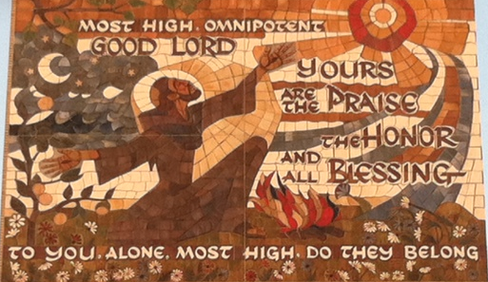
Sense of Creation as Family “For His praise, I wish to compose a new hymn about the Lord’s creatures, of which we make daily use, without which we cannot live, and with which the human race greatly offends its Creator.” St. Francis’s reason for composing the Canticle of Brother Sun
A musical interpretation of the original 9 verses: http://www.youtube.com/watch?v=LB1hO0i-yVc
Notes:
For more on this topic resource the AFCU “Poverty” module 2 found on their website http://franciscancollegesuniversities.org/resources/#category_id_57.
Narration: “This magnificent hymn expresses the mystical vision of the Saint of Assisi and , since it springs from the depths of his soul, provides us with many insights into the profundity of his life of faith in the Triune God, Who so deeply enters into creation.” writes Regis Armstrong. It not only is a piece of spiritual literature written at a significant time in the development of language but also holds a profound theological worldview at the heart of the Franciscan intellectual tradition.

Slide 78
The Canticle of Brother Sun¹
¹Most High, all powerful, good Lord, Yours are the praises, the glory, the honor, and all blessing.
²To You alone, Most High, do they belong, and no man is worthy to mention Your name.
³Praised be You, my Lord, with all your creatures, especially through my lord Brother Sun, who is the day; and through whom You give us light.
⁴And he is beautiful and radiant with great splendor; and bears a likeness of You, Most High one.
⁵Praise be You, my Lord, through Sister Moon and the stars, in heaven. You formed them clear and precious and beautiful.
⁶Praised be You, my Lord, through Brother Wind, and through the air,
cloudy and serene, and every kind of weather through which You give sustenance to Your creatures.
⁷Praised be You, my Lord, through Sister Water, which is very useful and humble and precious and chaste.
⁸Praised be You, my Lord, through Brother Fire, through whom you light the night and he is beautiful and playful and robust and strong.
⁹Praised be You, my Lord, through Sister Mother Earth, who sustains us and governs us and who produces varied fruits with colored flowers and herbs.
¹⁰Praised be You, my Lord, through those who give pardon for Your love, and bear infirmity and tribulation.
¹¹Blessed are those who endure in peace for by You, Most High, they shall be crowned.
¹²Praised be You, my Lord, through our Sister Bodily Death, from whom no living man can escape.
¹³Woe to those who die in mortal sin. Blessed are those whom death will find in Your most holy will, for the second death shall do them no harm.
¹⁴Praise and bless my Lord, and give Him thanks and serve Him with great humility.
AMEN
Notes:
Sources:
1. Francis and Clare The Complete Works, Translation and Introduction by Regis J. Armstrong, O.F. M. CAP. And Ignatius C. Brady, O.F. M. (1982) Paulist Press, New York, NY.

Slide 79
Historical Significance
The Canticle was written in Italian with music composed for it in order “to communicate a distinctive experience of God to everyone.”²
Composing the Canticle in Italian is significant because written works at that time were in Latin, including most of Francis’s writings, but Italian was the language of the people.¹
It was written at 3 different times¹:
verses 1-9—after Francis received the stigmata and was experiencing intense suffering.
Verses 10-11—were added when Francis sent the brothers to sing it to quarreling civil and religious authorities
Verses 12-13—on his death bed
Verse 14—may have been a refrain used after each verse.
Notes:
Sources
1. Francis and Clare The Complete Works, Translation and Introduction by Regis J. Armstrong, O.F. M. CAP. And Ignatius C. Brady, O.F. M. (1982) Paulist Press, New York, NY.
The Franciscan Intellectual Tradition: Tracing Its Origins and Identifying Its Central Components, Kenan B. Osborne, O. F. M. (2003) Bookmasters , Inc. Mansfield, OH.

Slide 80
Why is The Canticle Important?
To know creation is to know God.
God’s image is in creation
While these statements seem obvious, in Francis’s time it was somewhat revolutionary to consider seeking God within the world, the people, and the relationships around you.
God’s goodness and all loving nature can be understood through all of creation.
In creation, God brought something from nothing.
God created not because God is all powerful but because God has unlimited love and freedom. In The Canticle, we are to understand that we are created in relationship: relationship to one another, to the sun, to the moon, to the water, to all of the earth and even to death. We are siblings with all that God has created.
Another way to look at this is to think of God’s presence as completely enveloping us—each of us reflect some aspect of the divine fullness. Collectively, we create a picture of a beautiful, loving God who created us not to be alone but to be in relation to all that is around us, which in turn puts us in relationship with God.
Notes:
For more on this topic resource the AFCU “Franciscan Reflections on Creation” Module 5 found on their website.
Sources
3. The Franciscan Intellectual Tradition: Washington Theological Union Symposium Papers 2001, ed. Elise Saggau, O. S. F. (2002) Bookmasters Inc. Mansfield, OH.

Slide 81
The Canticle of Brother Sun in the Classroom
"If things created are so full of loveliness, how resplendent with beauty must be the One who made them!“ St. Anthony of Padua
Notes:
To Be Narrated:
“I do not teach this poem in my chemistry and biochemistry courses, yet elements of it are there. I am careful not to bring too much of my faith into the classroom or laboratory because I do not want to offend or upset my students. However, I do point out the marvel and wonder of the created world around us. The strength of the bonds, which leads to the simplicity of the molecules that in turn create the great diversity of cells and organisms. We are studying the principles or laws that govern the formation of these bonds and from this view point, we can see how all creation is in relation to each other. In this way, I am sharing some of the profound awe that Francis had in the revelations of the relationships in creation in his time.”

Slide 82
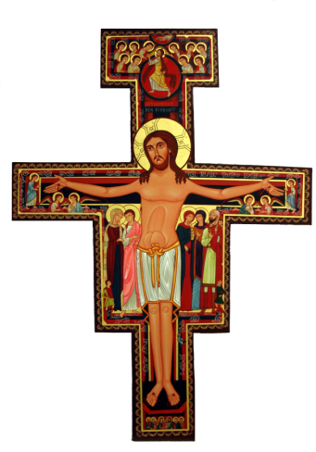
Reflection
What aspect of the Canticle might you incorporate into your class?

Slide 83
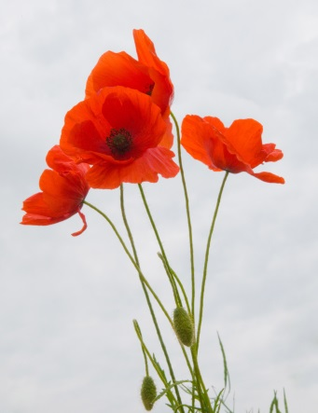
The Franciscan Moral Vision… (Responding to God’s Love)
is a Catholic Trinitarian wisdom tradition that
acknowledges real-world tensions (e.g. institutional/charismatic, past/future, universal/particular, act/person),
understands human failings and growth in context of time, history & human contingency,
recognizes the human limitations of reason & philosophy, also the reality of sin,
embodies a distinct social vision connecting personal/political, individual/communal, singular life of virtue/anticipation of Reign of God for all.
Notes:
CHARACTERISTICS
Responding to God’s Love
Thomas Nairn, OSF & Mary Beth Ingham, CSJ,
Franciscan Forum X: Responding to God’s Love,
March 29, 2014
Colorado Springs, CO
Narration: “This spirituality received its theological articulation in the writings of the early Franciscan masters, including Alexander of Hales, St. Bonaventure and Blessed John Duns Scotus, who grounded their work in a theology of the Trinity which sees God as self-diffusive goodness and insists that God’s very nature is relational. This strong Trinitarian emphasis is complemented by an equally strong Christological emphasis, centering particularly on the Incarnation, which those Franciscans have described in terms of God’s sharing this diffusive goodness in that union with creation that could return love in a supreme way.¹ These masters understand Christian morality therefore as a response to the extravagant love of God. Without denying human limitations and sin, the Franciscan tradition offers the Church an aesthetic moral vision in which humanity is called to reflect the beauty of God.”
-----------------------------------------------
¹See John Duns Scotus, Reprtatio Parisiensis II, d. 20, q. 4, 5.

Slide 84
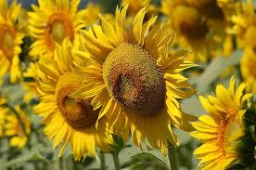
The Franciscan Moral Vision…(Responding to God’s Love)
is a response to the reality of God’s love by
developing free & self-giving relationships with others,
respecting every person profoundly as an Image of God,
embracing dynamic realization of creative & loving freedom,
imitating Christ as Moral Exemplar in context of a universal vision that includes all creation.
is an aesthetic vision: moral life is good/beautiful because God and creation are good/beautiful.
Notes:
CHARACTERISTICS presented at Franciscan Forum X: Responding to God’s Love, over March 29, 2014 at Colorado Springs, CO
by: Thomas Nairn, OFM & Mary Beth Ingham, CSJ, Joseph Chinnici, OFM
These characteristics may be articulated in the following manner (The Franciscan Moral Vision: Responding to God’s Love edited by Thomas A. Nairn, OFM, Franciscan Institute Publications, 2013):
Characteristic #1: The Franciscan moral vision affirms on the human level that there is a mirroring of the free and self-giving exchange of Father, Son, and Holy Spirit that calls people to live in free and self-giving relationships of mutuality.
Characteristic #2: The Franciscan moral vision emphasizes a dynamic realization of creative and loving freedom in response to God’s love.
Characteristic #3: The Franciscan moral vision recognizes each person as an Image of God. Since each person reflects the creativity of God in an individualized ay, each person must be treated with profound respect.
Characteristic #4: The Franciscan moral vision is Christological in its emphasis on the Exemplarity of Christ and upon the the Incarnation, Redemption, and Consummation of all things in Christ. It is thus profoundly Christian and Catholic, respectful of the Church’s moral Magisterium, but at the same time it is universal and inclusive of all creation.
Characteristic #5: The Franciscan moral vision takes into account the issues of time, history, and human contingency. Human growth means development and conversion. Human solutions are not perfect but are perfectible.
Characteristic #6: At the same time, the Franciscan moral vision accepts an Augustinian vision of the person that recognizes human limitations, including the real limitations of human reason and philosophy, and the reality of sin.
Characteristic #7: The Franciscan moral vision is a holistic vision that involves a spiritual discernment by the while person, intellectual, affective, and volitional. It acknowledges the importance of community in discernment.
Characteristic #8: The Franciscan moral vision is an aesthetic vision, recognizing that the moral life is one of beauty, reflecting the beauty of God.
Characteristic #9: The Franciscan moral vision is more properly understood as a wisdom tradition rather than a scientifically organized system of analytic thought.
Characteristic #10: The Franciscan moral vision incorporates within it a tension that arises out of respect for both sides of several polarities – the institutional and charismatic, the universal and particular, the past and the future, the act and the person. It acknowledges that this tension is part of living as a pilgrim in this world.
Characteristic #11: The Franciscan moral vision embodies a distinct social vision that intersects the personal with the political, the individual with the communal, the singular life of virtue with the anticipation of the Reign of God for all.
We do not claim that these characteristics are unique to the Franciscan moral vision and not shared by others. We do claim, however, that these characteristics
Are essential to the integrity of the Franciscan vision itself. Without them the vision would cease to exist.

Slide 85
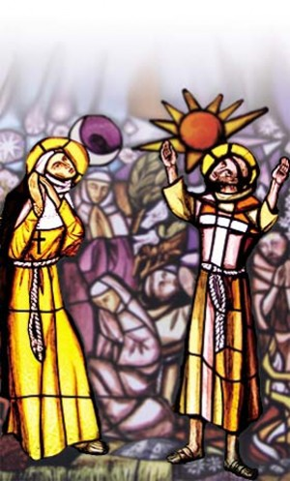
“. . . is an aesthetic moral vision in which humanity is called to reflect the beauty [and extravagant love] of God.”*
God is good; Creation is of God, and is therefore good.
As moral agents, people are to be seen first and foremost as mirrors of God in the context of creation.
Focus on sin--you will find and perpetuate it; focus on goodness--you will find and perpetuate it.
Individuals have community and nature to help and support each person, to learn not to “be good,” but learn goodness itself as a gift of Creation and come to desire goodness.
God’s love creates the possibility for our response, in imitation of God’s Incarnated Example. The beauty of Nature is a sign of God’s love.
"In beautiful things [Francis] discerns/sees Beauty Itself.” (2C165; full reference in notes below.)
Merged stained glass windows in San Damiano
* See notes for slide 84: Characteristics.
Notes:
– Thomas Nairn, OSF & Mary Beth Ingham, CSJ, Characteristics handout from Franciscan Forum X: Responding to God’s Love, March 29, 2014 in Colorado Springs, CO
The full reference to the Francis quote on follows: In art he praises the Artist; whatever he discovers in creatures he guides to the Creator. He rejoices in all the works of the Lord's hands, and through their delightful display he gazes on their life-giving reason and cause. In beautiful things he discerns/sees Beauty Itself; all good things cry out to him: "The One who made us is the Best." Following the footprints imprinted on creatures, he follow his Beloved everywhere; out of them all he makes for himself a ladder by which he might reach the Throne."

Slide 86
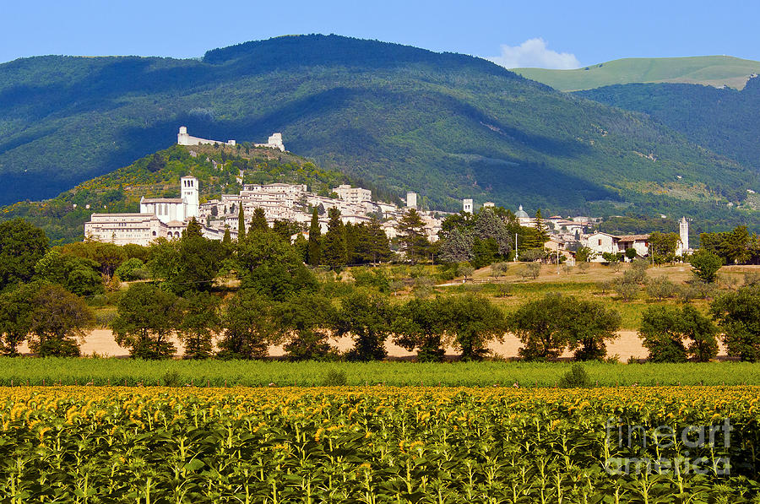
Reflection
Teaching could be considered a very Franciscan endeavor. As faculty, we strive to challenge our students, to push them beyond the limitations, and to support them when they fail. We want them to see ways in which they can bring good to communities in which they live. Consider how in your teaching, both within and outside the classroom, what you do could be modeling or connecting with the Franciscan ideal that we are the ones who model and bring into reality goodness.
Notes:
Fields of sunflowers and poppies in the Assisi valley

Slide 87
Saint Francis of Assisi as Student and Teacher
87

Slide 88
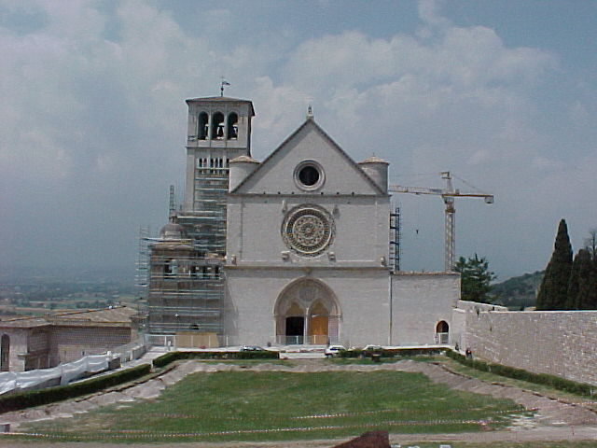
The Basilica of Saint Francis in Assisi Located on the site known as the “Hill of Hell” to become known as the “Hill of Paradise”
88

Slide 89
Introduction to Saint Francis: Resources
Read the link on St. Francis’s lifehttp://198.62.75.1/www1/ofm/fra/FRAlife1.html
Watch the short video overview of Francishttps://www.youtube.com/watch?v=kw1LDSV23zA
How did Francis learn and grow by reflecting on his experiences?
How did Francis engage in “self-assessment” as part of his process of learning and growing spiritually?
Name some of St. Francis’s values and how they relate to his understanding of Jesus and his Catholic Christian faith
89

Slide 90
The Education of Francis the Student
As a child Francis attended school at his church and learned to read, write, and the basics of his Catholic faith
His youthful experiences with working class people—his father was a cloth merchant—enabled Francis to appreciate the material value of creation; working with raw materials by hand gave him a closer connection creation.
He developed a positive, biblical understanding of creation as a source of wisdom—creation reveals God (e.g. Psalms 19:1-7; 104:24)
For Francis, the pursuit of knowledge must lead to a deeper love of God
Francis’s love for creation developed gradually as he deepened his love for God: conversion from sin and its destructiveness to a deeper awareness of the sanctity of all human life and creation
His biographer, Celano, and St. Bonaventure describe Francis’s conversion through his ever-growing relationship with Jesus Christ
The Crucified Christ becomes central to Francis’s understanding of the transformative power of LOVE
Creation created by God’s Word, manifested in Jesus Christ, led hit to view all creation as good, with our ultimate goal as heaven—the “Garden of Innocence” (Genesis 1-3)
90

Slide 91
Learning through Life
Francis experienced the church and world as a man of his time and culture
Francis’s high ideals to be a knight were dashed when he became a prisoner of war; he suffered health problems, and eventually went to work for his father and lived a life of “pleasure,” which soon proved unfulfilling.
In his contemplative treks to the countryside he encounters a leper and reaches out to him
He has his vision in the dilapidated church of San Damiano and gathers resources from his father’s store to “pay” for its restoration—but the priest rejects his offer
Francis begins to live as an “oblate” and deepens his spiritual life
This leads to open conflict with his father
91

Slide 92
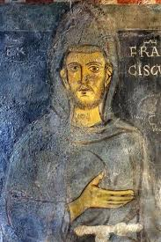
Reflection
How does Francis learn from his own mistakes?
What makes him reject wealth and privilege to embrace a life of voluntary poverty?
How does his outward work of repairing churches lead to an inward conversion?
Why do you think he joyfully internalized Jesus’ call to his apostles to go forth and preach, living a life of simplicity and poverty?
Notes:
Fields of sunflowers and poppies in the Assisi valley

Slide 93
Francis’s Nature Mysticism
Contemplation of creation deepens his consciousness of God and the unity and sanctity of all life as a sacrament—a visible sign of God’s transcendence and grace
Francis embraces a biblical view of the mystery of suffering as an essential aspect of our humanity—the suffering of Jesus illuminates and explains human suffering as redemptive
Francis’s conversion centers on three images:
The Crib—the Incarnation of Jesus
The Way—the ministry and mission of Jesus
The Cross—the death of Jesus as the fulfillment and completion of his ministry (Mark 15:38)
The Suffering of Jesus enables us to encounter the love of God
Contrast: The Cathars
A dualistic sect that held a negative view of creation emphasizing the dichotomy between matter and spirit
The Cathar movement was popular in Francis’s time and even in his city
Emphasizes an escape from the hardships of life by focusing on escaping the material world to enter the spiritual world
Cathars respond to suffering by rejecting the value of creation and opposing the physical and spiritual
93

Slide 94
Francis learns from Jesus: applying the Gospels
Francis embraces a life of poverty, living simply and dedicating himself and his community to a life of prayer and service
Care for the needy becomes a central aspect of Francis’s and the Franciscan movement
Care and love for creation and humanity go hand-in-hand; the call to love and steward all creation is rooted in his understanding of all creation as good, reflective of its divine source, and that humans are created in God’s image and likeness
Jesus embraced his Jewish values to teach that we must love one another and have a special care for the poor and needy
Matthew 25:31-46 a parable in which Jesus describes the final judgment, when God, a “shepherd” and “king” will judge people based on how they treated others:
Whatsoever you do to the least of my brothers and sisters, so you do unto me
94

Slide 95
Francis learns from Jesus: applying the Gospels
Jesus heals the leper (Mark 1:40-45). Lepers were considered “unclean” and sinners who must be avoided lest one be contaminated by them. Jesus embraces and heals the leper, breaking societal taboos and showing his love for the dignity of all human beings
Jesus’ self-giving love manifested in his humanity, teaching, healing, Cross and Resurrection reflects the love of God for all humanity and creation
The Risen Jesus empowers his disciples to continue his transformative mission (Matthew 28:16-20; Acts 2)
Francis encounters a leper; previously Francis loathed lepers and avoided them but encounters a leper on the road and is moved with love and compassion to give him alms.
Francis’s reflection on the humility of Christ reflected in the Incarnation and self-giving of the Cross moves him to love give his love and care for the suffering.
Francis receives a mystical vision and call to repair the Church; he begins by repairing a dilapidated church in Assisi and then broadens his mission by dedicating his life to repairing the Church by establishing a community dedicated to bringing the love of Christ to all people.
95

Slide 96
Francis’s Biblically based View of Creation
Psalm 19:2-7
The heavens declare the glory of God; the firmament proclaims the works of his hands.
Day unto day pours forth speech; night unto night whispers knowledge.
There is no voice, no words; their voice is not heard.
A report goes forth through all the earth; their messages to the ends of the world. He has pitched in them a tent for the Sun.
It comes forth like a bridegroom from his canopy; and like a hero joyfully runs its course.
From one end of the heavens it comes forth; its course runs through the other; nothing escapes its heat.
Saint Francis’s “Canticle of the Creatures” is one of his most famous prayers, composed later in his life. Click the link below to read the prayer and get background on its composition
http://www.custodia.org/default.asp?id=1454
96

Slide 97
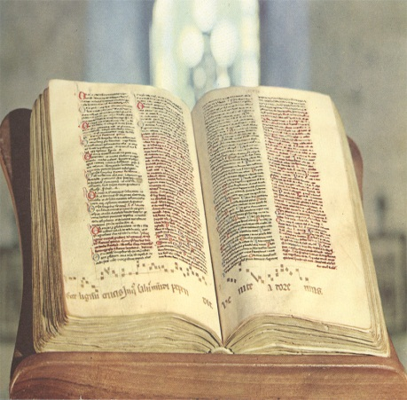
Reflection
How does Francis’s prayer reflect biblical values as found in Psalm 19 or Genesis?
Why do you think Francis personifies elements of creation as “brother” and “sister”?
How does his understanding of creation reflect his view of death?
Discuss: how can Francis’s views of creation inspire us to better care for human life and our environment?
Francis’s life experiences were an ongoing source of transformation and learning; the Canticle of Creatures, for example, was written later in his life.
Discuss how Francis’s ongoing transformation and learning can serve as a source of inspiration for our ongoing spiritual and intellectual growth.

Slide 98
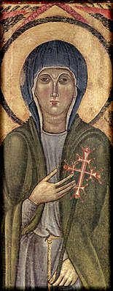
Francis the Teacher
Student: Clare of Assisi
Read the link below for background on Clare’s life and works
http://198.62.75.1/www1/ofm/fra/FRAwrc01.html
Click the link below to access an article from Franciscan Studies recounting how on Palm Sunday, 1211, Clare left her home and entered the Franciscan community at the Portiuncula chapel
http://i-tau.com/franstudies/articles/St_Clare_Palm_Sunday.pdf
Clare lived from 1193-1254 and came from a noble family in Assisi.
She desired to join Francis’s movement and eventually escaped from her family home and found refuge with Francis, received the habit, and eventually started her own community under Francis’s patronage.
She represents the “feminine” expression of Franciscan ideals.
98

Slide 99
Clare’s Spirituality and Mysticism
Clare and her sisters lived in close proximity to Francis and his friars; they were cloistered and embraced voluntary poverty
Clare resisted attempts by Church officials, including Pope Innocent IV, to control the sisters’ way of life—Clare insisted on poverty and created her own rule which was eventually accepted by the Pope
Clare was a mystic; her four Letters to Agnes of Prague provide insight into her mystical practices.
“The Mirror” is an image Clare used to contemplate Christ
Clare’s spirituality is influenced by Francis but reflects her own unique mystical and communal experiences as a woman living in community with her sisters.
Clare provides an example of a strong woman of faith who bravely stood up for her beliefs—even resisting papal efforts to exercise control over her community.
She models the values of simplicity of life and contemplation—aspects of her spirituality that remain relevant in our contemporary world. See the link below for more on Clare and her Letters:http://198.62.75.1/www1/ofm/fra/FRAwrc02.html
99

Slide 100
Francis the Teacher
Student: Bonaventure
See the link below for an artistic image of Bonaventurehttp://allart.biz/up/photos/album/B-C/Vittorio%20Crivelli/vittore_crivelli_4_saint_bonaventure.jpg
Read the link below for background on Bonaventure’s life and works:http://www.franciscan-archive.org/bonaventura/
Bonaventure of Bagnoregio (1217-1274) believed he was miraculously cured by St. Francis as a child; he later studied at the University of Paris and became a Franciscan in 1243. He received advanced degrees and became a theologian who composed many biblical, theological and mystical works. He became Minister General of the Franciscan order in 1257 and was declared a Doctor of the Church in 1588 by Pope Sixtus V—the “Seraphic Doctor.”
100

Slide 101
Bonaventure’s Spirituality and Mysticism
During a visit to Mt. Alverna, where Francis experienced a vision of a six-winged seraph, Bonaventure himself had a mystical experience which led him to compose The Journey of the Mind to God. He begins by mentioning his mentor, Francis, and how he had a vision of the six-winged seraph, which he interprets in terms of six stages of ascent to communion with God. The following link provides an introduction and English translation:http://www.crossroadsinitiative.com/library_article/666/Journey_of_the_Mind_into_God_St_Bonaventure.html
The “ladder” of spiritual ascent begins in the created world, where the purified mystic enters into the way of God’s truth through devotion and contemplation of God’s name
One enters “our own mind” which is “God’s image” and ascends to what is “eternal, totally spiritual, and above”
The six wings are likened to the six days of creation leading to the Sabbath rest
The Ark of the Covenant is an image of Christ as the “door” and “staircase” to God’s presence
One enters the “Sabbath” rest of divine darkness and a “rapture of pure mind”
101

Slide 102
Summary: Franciscan Intellectual Values
We learn from our experiences and observations
The pursuit of knowledge should lead to a love of God and all creation
Scientific knowledge promotes harmony with God and creation
Morality and wisdom underlay the holistic Franciscan approach to learning
Knowledge enables us to respond positively and constructively in response to problems as we better appreciate the sanctity of all creation as divinely-ordered and therefore become better stewards
Three points: 1) Nature is Good because it is of God and can lead us to God; 2) the pursuit of knowledge is a communal activity, working in dialogue and collaboration with others; 3) the pursuit of knowledge must have a moral purpose—to promote the common good.
102

Slide 103
Beauty in the Franciscan Tradition
Creation serves as the starting point for a “ladder” of spiritual ascent to communion with God
The beauty of creation provides a “sacramental” experience of the ineffable Creator
Awareness of God through the beauty of God’s creation leads us to the ultimate beauty and joy
Creation is eschatological: it points to our ultimate end and goal of communion with God
Three Movements in the Spiritual Ascent
Awareness: We experience beauty through observation and experience in our daily lives
Unfolding: We contemplate our experiences internally and draw closer to God as its source
Embrace: We experience self-transcendence and are enveloped in the overwhelming love of God
Incarnational Theology
All creation and humanity is a reflection of God as its source
The Incarnation of Jesus Christ is the ultimate expression of God’s love for and union with humanity
The self-giving love of Jesus is reflected in his redemptive suffering
We unite ourselves to the Cross of Jesus as the ultimate source of meaning and hope
We love and care for all humanity and all creation as sacred
103

Slide 104
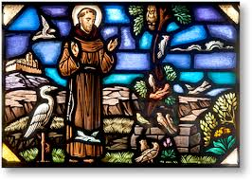
Francis’s “Vernacular Theology”
104

Slide 105
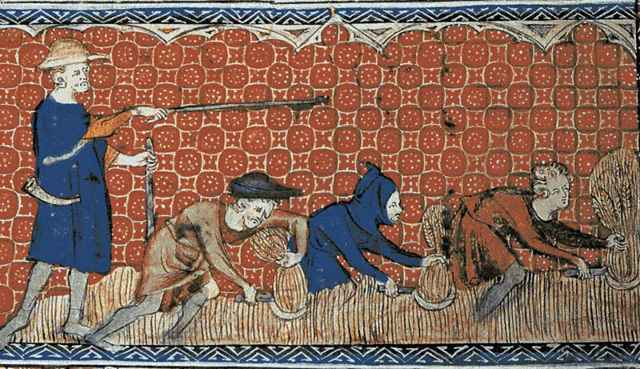
The 13th century: The Flowering of Mysticism
The 13th century was a period when mysticism “flowered” among the laity. Spirituality became more democratized and secularized. The focus of this movement was the experience of God in the lives of the literate as well as the illiterate, the wealthy as well as the poor.
105

Slide 106
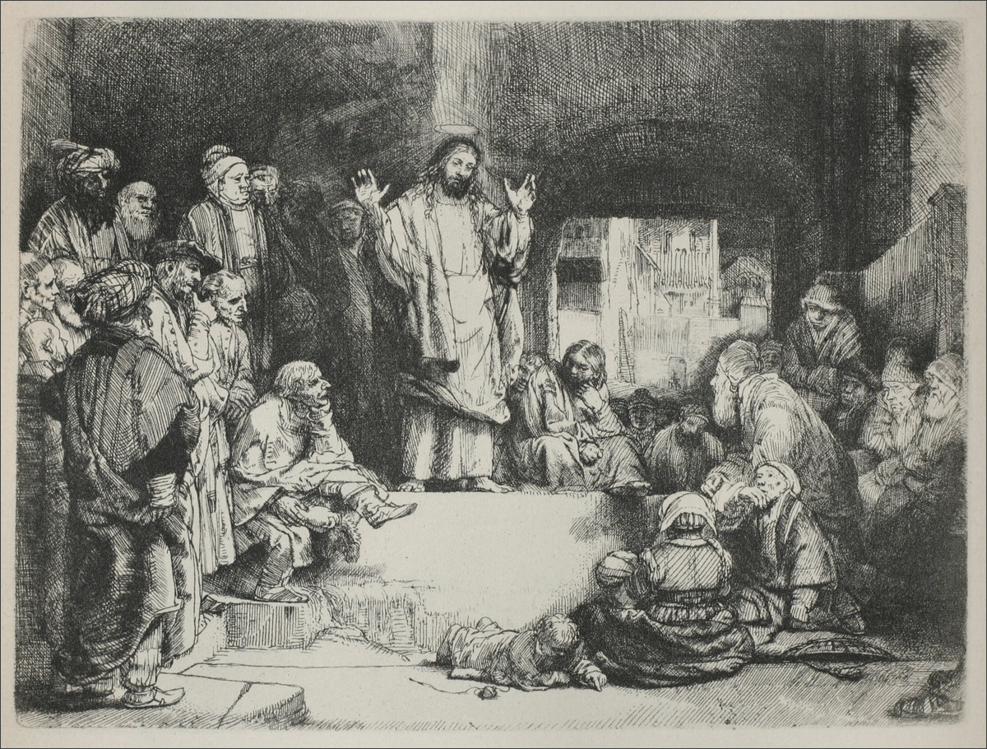
Francis of Assisi was a crucial player in the growth of this spirituality in that his preaching was accessible to the “ignorant” and “uneducated” (among which Francis counted himself).
106

Slide 107
“Vernacular Theology”
This term was coined by theologian Bernard McGinn to refer to a theology focused on reaching an audience of these “ordinary” people who seek an experience God in the routines of their daily lives.
Since Francis was so adept at facilitating this, he is referred to as the first “vernacular theologian.” He had the gift of being able to articulate the profound experience of God in the vernacular language of his audiences.
107

Slide 108
A “vernacular theologian”
A “vernacular theologian,” then, is one whose writing and life demonstrates that ALL persons can and do experience God in the midst of the world. The vernacular theologian’s mission is to communicate this truth to the ordinary person.
The thirty or so works Francis left behind (mostly prayers and letters) illustrate this focus. Even though most of these are in Latin, they still can be classified as examples of “vernacular theology” since it is apparent that Francis developed these thoughts in Italian and only then tried to articulate them in Latin.
108

Slide 109
Francis’s view of God and creation as reflective of vernacular theology
Francis considered everything in his life to be a gift from an all loving and all good God.
The limitless goodness of God exists within the relationship of the three persons of the Trinity and cannot but overflow into all of creation.
It is in this light that we can be called “sons and daughters of God” since we have been incorporated into the very relationship that is the essence of God.
109

Slide 110
Francis’s view of God and creation as reflective of vernacular theology
This relationship is reflected in Francis’s use of plural pronouns in his prayers recorded in the Early Rule.
“With our whole heart, our whole soul, our whole mind, with our whole strength and fortitude, with our whole understanding…. Let us all love the Lord God, who has given and gives to each one of us our whole body, our whole soul, and our whole life, who has created, redeemed, and will save us by His mercy alone, who did and does everything good for us.” (Ch. 23)
110

Slide 111
Holy Spirit as our “spouse”
Our incorporation into the relationship that constitutes the triune God can be seen in Francis’s habit of referring to every committed Christian as “Spouse of the Holy Spirit.”
The Spirit is the bond of love. Therefore, all Christians are called to being open to the power of the Holy Spirit (love) and thus willing to be transformed into what God desires.
111

Slide 112
Significance of Holy Spirit as “spouse”
Theologian Dominic Monti calls Francis’s image of the Holy Spirit as spouse one of the most profoundly original contributions of Francis as a vernacular theologian.
112

Slide 113
The Canticle of Brother Sun as an example of Vernacular Theology
Francis wrote this canticle in Italian (the common language of his audience). The fact that he composed music for it indicates that he wished it to be circulated that way. This would make it accessible to the uneducated laity.
The canticle of the sun is considered the first great poem of the Italian vernacular. In fact, it has even been called the most ancient spiritual poem in any vernacular language.
The canticle clearly shows the focus of vernacular theology: that God is encountered by and through the beauty of the natural world around us which reflects the perfect goodness of God.
Throughout the canticle, Francis writes of his experience of God through his brotherhood with the elements of creation.
The constant repetition of the terms “brother and sister” illustrate the intimate relationship all of creation shares with the all-loving, all-good, all-powerful God. This hearkens back to the primacy of relationship which can be seen within the triune God.
Each creature is called upon to praise God since each is a beautiful expression of God’s presence.
113

Slide 114
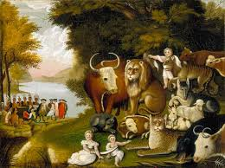
… a theme which is repeated in Francis’s Admonitions…
“… And all creatures under heaven serve, know and obey their Creator, each according to its own nature, better than you.” (Admonition 5)
114

Slide 115
The structure of the Canticle of the Sun
Consisting of 14 stanzas (which is seen by some to symbolize the 14 stations of the cross) and 33 lines (perhaps signifying Jesus’ age at the crucifixion), the poem is divided into three distinct parts.
The first 5 stanzas deal with the heavens. The next 4 stanzas focus on the earth. The final 5 stanzas concern human beings.
115

Slide 116
Significance of the Canticle….
The perfect symmetrical structure reflects the medieval sense of the order which was thought to indicate proximity to the Divine.
Bernard McGinn considers this piece Francis’s most strikingly creative contribution as a vernacular theologian.
116

Slide 117
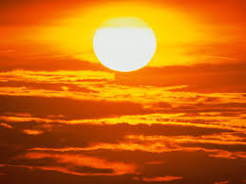
The Canticle of Brother Sun
Most High, all powerful, good Lord, Yours are the praises, the glory, the honor, and all blessing.
To You alone, Most High, do they belong, and no human is worthy to mention Your name.
Be praised, my Lord, through all your creatures, especially through my lord Brother Sun, who brings the day; and you give light through him. And he is beautiful and radiant in all his splendor! Of you, Most High, he bears the likeness.
117

Slide 118
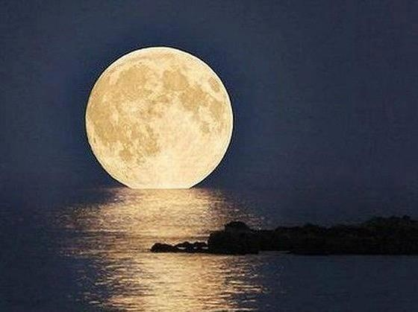
Praise be You, my Lord, through Sister Moon and the stars, in heaven you formed them clear and precious and beautiful.
Praised be You, my Lord, through Brother Wind, and through the air, cloudy and serene, and every kind of weather through which You give sustenance to Your creatures.
Praised be You, my Lord, through Sister Water, which is very useful and humble and precious and chaste.
118

Slide 119
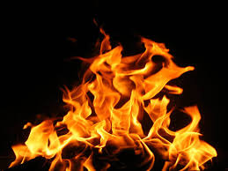
Praised be You, my Lord, through Brother Fire, through whom you light the night and he is beautiful and playful and robust and strong.
Praised be You, my Lord, through Sister Mother Earth, who sustains us and governs us and who produces varied fruits with colored flowers and herbs.
Praised be You, my Lord, through those who give pardon for Your love, and bear infirmity and tribulation.
Blessed are those who endure in peace for by You, Most High, they shall be crowned.
119

Slide 120
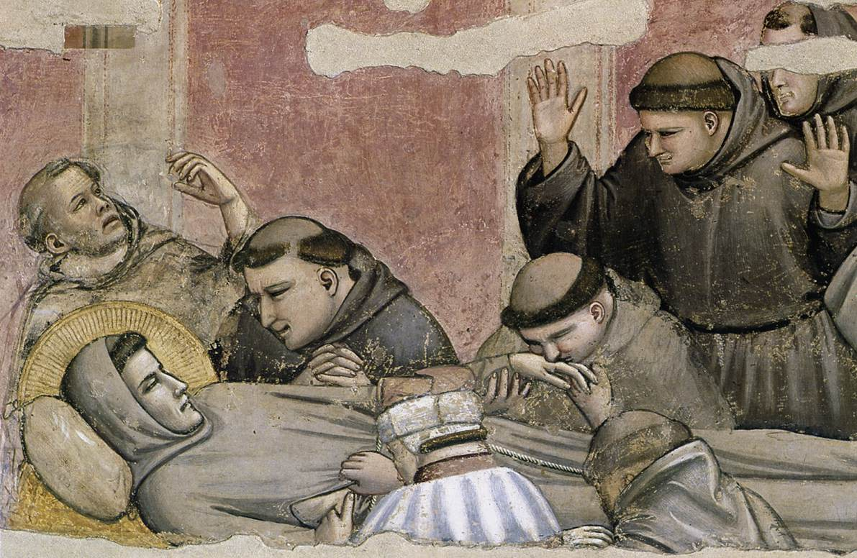
Praised be You, my Lord, through our Sister Bodily Death, from whom no living man can escape.
Woe to those who die in mortal sin. Blessed are those whom death will find in Your most holy will, for the second death shall do them no harm.
Praise and bless my Lord, and give Him thanks and serve Him with great humility.
120

Slide 121
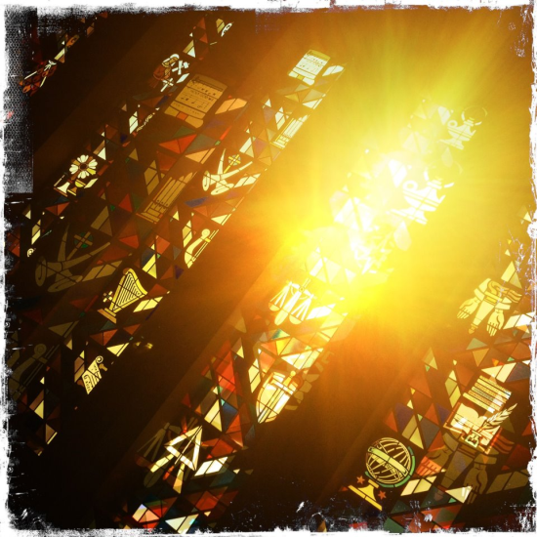
Reflection
Which verse of the Canticle has given me a new perspective on the element of nature that Francis is describing?
How does that verse reawaken in me an appreciation for creation as a vehicle of God’s communication and love?
121

Slide 122
A summary of the characteristics of vernacular theology:
Accessible to the ignorant and uneducated
Designed to reach an audience seeking an experience of God in their daily lives
Written in the common language of the time
The created world is a vehicle of God’s communication; that is where we encounter God
The limitless goodness of God overflows into all of creation
We are sons and daughters of God because we have been incorporated into this relationship of goodness and overflowing love
As such, we are also “spouses of the Holy Spirit”
122

Slide 123
Outline of the Methodology of Vernacular Theology
Vernacular theology reflects the belief that one “knows” not only by the head, but also by the heart.
The vernacular theologian appreciates this and attempts to make the experience of God accessible to all people.
In this sense, they engage in a theology that is “practical” in that it is accessible to and can be experienced by all.
123

Slide 124
Examples of Vernacular Theology from Francis’s Admonitions….
Where there is charity and wisdom,
there is neither fear not ignorance.
Where there is patience and humility,
there is neither anger nor disturbance.
Where there is poverty with joy,
there is neither greed nor avarice.
Where there is rest and meditation,
there is neither anxiety nor restlessness.
Where there is fear of the Lord to guard an entrance,
there the enemy cannot have a place to enter.
(Admonition 27)
124

Slide 125
Do we speak their language?
Joseph P. Chinnici, OFM described a Franciscan intellectual as …
“ascending low enough so as to enter into a community of teachers and learners; a community that values the languages of life, the many different languages of those who speak God.”
(from talk given at Washington Theological Union, May 2001.)
125

Slide 126
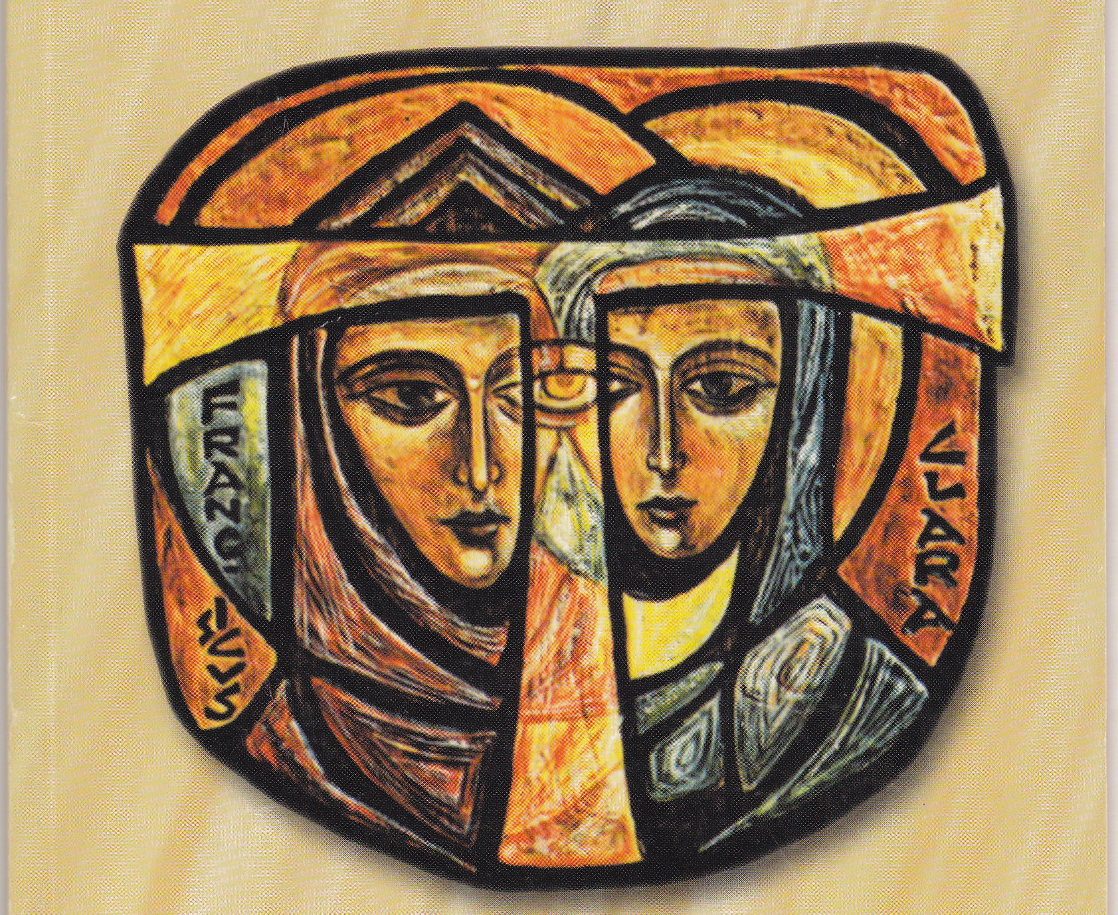
Reflection
Can we as faculty members speak “the language of God” while transmitting the content of our disciplines?
Are the two mutually exclusive?
What is the one concept in my own discipline that best lends itself to a theological articulation that might bring my students closer to an understanding of God?
126

Slide 127
Resources
Read “Francis as Vernacular Theologian” by Dominic Monti OFM
http://www.franciscantradition.org/images/stories/custodians/03_Francis_as_Vernacular_Theologian.pdf
For further reading: The Flowering of Mysticism: Men and Women in the New Mysticism by Bernard McGinn (NY: Crossroad, 1998)
127

Slide 128
Sample Courses Infused with Franciscan Intellectual Tradition
128

Slide 129
How to Infuse Your Course with the Franciscan Intellectual Tradition
The following slides offer examples of courses from different areas of study.
Each course has an element of the Franciscan Intellectual Tradition incorporated in the content.
These slides show the course subject and the way in which the FIT can be infused in such a course.
The courses also include special first year seminar topics for those schools that offer such courses.
The slides include information about which materials will aid in the presentation of this content.
129

Slide 130
Intercultural Communication
View lecture: The Saint and the Sultan
Conduct discussion on the applications of the story concerning ethnocentrism, cultural relativism, communication with the “other,” dialogue, and mindfulness.
Students write a reflection on this story in relation to other intercultural communication scenarios
http://learn.ctu.edu/content/duns-scotus-lecture-saint-and-sultan
130
Notes:
Note: This lecture, The Saint and the Sultan, can be found at http://learn.ctu.edu/content/duns-scotus-lecture-saint-and-sultan

Slide 131
Writing and Activism
Discussion of Compassion in relation to Poverty.
Francis on Poverty: Readings on the Rule and thoughts on Lady Poverty
Visits to House of Peace Capuchin Ministries and St. Ben’s Community Meal Program
Written reflection on Poverty, Compassion, and our activist responses
131

Slide 132
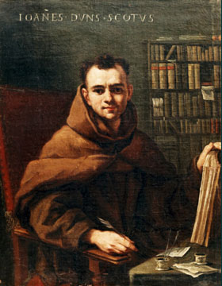
Persuasion
Present the topic of what constitutes ethical approaches to persuasion
Review the Franciscan teacher and philosopher John Duns Scotus on the construct of haecceitas, thisness or the unique quality or identity which makes each one unique.
If each member of creation bears this uniqueness, how should we treat each person in trying to persuade?
132

Slide 133
Spanish: Multicultural Studies
Students identify a group suffering from oppression, discrimination, and/or persecution, e.g. undocumented children in immigration detention
Students read current Franciscan thoughts on compassion
Students read and discuss segments of the Earlier Rule: Chapter XVII: Preachers (“preach by their deeds” and “humble themselves in everything.”)
Students incorporate these ideas into their presentations on the group identified
133

Slide 134
General Psychology
Examine stories from biographies of Francis, such as the Fioretti, about bettering a community, e.g. expulsion of demons from Arezzo; the Wolf of Gubbio; "Canticle of the Creatures"; the segment on peace addressed to the Mayor and Bishop of Assisi
Students apply principles of psychology ( such as classical conditioning, operant conditioning, and observational learning) to creating a more caring community and identify these in the stories of the Fioretti.
134

Slide 135
Computer Science: Social Media Behind the Scenes
Discussion of emotional contagion of social media
Discussion of ethics in relation to usage of social media, especially in relation to Francis and the Canticle and John Duns Scotus and haecceitas.
Students present social media experiments and discuss ethical issues
135

Slide 136
Music: Sacred Sound
Focus on cross cultural awareness in worship music
Emphasize reverencing all of creation with reference to the "Canticle of Creation" as song
Have students visit two worship services and reflect in writing on their experiences in relation to music, cross cultural awareness, and having compassion for other traditions.
Provide regular listening quizzes to allow students to identify various important chants and devotional songs from different religious traditions
136

Slide 137
Mathematics for Elementary Teachers
Helping children find the joy in math
Patterns, Perspective, Math tricks
Story of Luca Pacioli, OFM, the Father of Accounting and Bookkeeping.
137
Notes:
http://famous-mathematicians.org/luca-pacioli/
“Paciolo also wrote a treatise on magic and mathematics, notable for being the first known guide to performing card tricks. As well as instructions on juggling and fire-eating, the book also included a collection of mathematical puzzles. For unknown reasons, it was never published in Paciolo’s lifetime, languishing in Bologna University’s archives and appearing in English only in 2007.
He also translated the Elements of Euclid and wrote a book about the application of proportion in architecture. This book is notable for its early use of skeletonic solids and for discussing the use of perspective in painting.”
http://www-groups.dcs.st-and.ac.uk/history/Biographies/Pacioli.html
“At Milan Pacioli and Leonardo quickly became close friends. Mathematics and art were topics which they discussed at length, both gaining greatly from the other. At this time Pacioli began work on the second of his two famous works, Divina proportione and the figures for the text were drawn by Leonardo. Few mathematicians can have had a more talented illustrator for their book! The book which Pacioli worked on during 1497 would eventually form the first of three books which he published in 1509 under the title Divina proportione (see for example [3]). This was the first of the three books which finally made up this treatise, and it studied the 'Divine Proportion' or 'golden ratio' which is the ratio a : b = b : (a + b). It contains the theorems of Euclidwhich relate to this ratio, and it also studies regular and semiregular polygons (see in particular [4] for a discussion of Pacioli's work on regular polygons). Clearly the interest of Leonardo in this aesthetically satisfying ratio both from a mathematical and artistic point of view was an important influence on the work. The golden ratio was also of importance in architectural design and this topic was to form the second part of the treatise which Pacioli wrote later. The third book in the treatise was a translation into Italian of one of della Francesca's works.”

Slide 138
First Year Seminar with Special Topics: Body Language
Focus on Reverencing Creation
Present story of Francis and the Leper
Witness repulsion change to Love
Consider Francis's declaration: "What was bitter is now sweet."
138

Slide 139
First Year Seminar with Special Topics: Martyrs, Mystics, and Women of the Street
Discussion of "The Great Idea" in relation to Francis. Why is what he did such a great idea that so many follow him?
Discussion of “rebuilding the Church” and the story of San Damiano
Discussion of Franciscan women preaching in the streets (Rose of Viterbo, Margaret of Cortona, Angela of Foligno, Elizabeth of Hungary)
Visit to Franciscan organizations in the city serving the underserved and women trapped in human trafficking.
Students write reflections on these experiences
139
Notes:
http://www.thegreatideas.org/

Slide 140
Spanish: Latinos in the US
Focus on Peacemaking
Stories of Francis and, first, his participation in war, then his rejection of war
Present guest speakers from the Latino community
Visit the Latino community center in the city and offer to volunteer
Students write reflections on these experiences in relation to peacemaking
140

Slide 141
Psychology of Gender
Focus on creating a caring community
Story of Francis and the Leper
Examine issues surrounding gender, sexism, feminism, sexual orientation, transgender identity
Student journals reflect on the issues in conjunction with creating a caring community
141

Slide 142
Mediation
Students watch video of In the Footprints of Francis and the Sultan from Franciscan Media
Class discussion of Francis and war, the Wolf of Gubbio, presenting the “Canticle of the Creatures” to the mayor and bishop of Assisi during their dispute
Students apply concepts of Franciscan peacemaking to a mediation scenario
142

Slide 143
Social Media
Presentation of content on writings of and about Francis
Students learn how to find content from the Early Documents
Students examine a public personality’s use of social media in relation to Franciscan values
For example, what do the Admonitions say? How does that connect to the way this person uses social media?
143
Notes:
http://www.prnewswire.com/news-releases/holy-name-province-announces-text-a-prayer-intention-to-a-franciscan-friar-to-celebrate-the-new-year-186071202.html

Slide 144
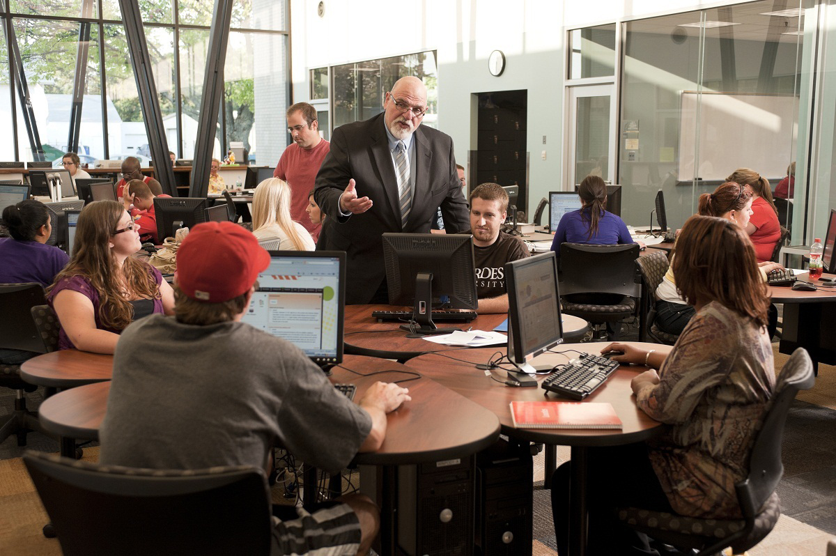
Developing Learning Activities

Slide 145
Developing a Learning Activity
Example 1 - Theatre
Conflict & Good News
One approach to [Western] theatre is that it is constructed on conflict. That is, the behavior of the [main] characters is driven by an attempt to resolve a conflict in which they find themselves. In other words, what causes the action of the play to occur is something that prevents the characters from attaining something they want. Without conflict, there may not be much of a play. That is, if the characters’ every wish is fulfilled, they may be happy, but there may not be much for the audience to witness or to contemplate.
The conflict may take many forms: individual v. individual, group v. group, individual v. group, individual/group v. outside forces, etc.
Notes:
.

Slide 146
Developing a Learning Activity Example 1 - Theatre
Conflict & Good News
Dramatists have approached this in many ways, but consider a few examples.
Two sons of a king fight on opposing sides of a war and kill each other in battle. The king declares that the son who fought for the winning city-state will receive a state burial. The son who fought for the opponents will be left to the elements, an ignoble fate. Their sister decides to bury her disgraced brother to follow the directives of the gods. (Sophocles, Antigone)
Two young people meet and fall in love. They would like to get married, but their families, currently involved in a feud that is roiling their town, would never accept this. (William Shakespeare, Romeo and Juliet)
A man takes in his friend after his wife informs him that she wants a divorce. Although their friendship is strong, they find themselves constantly at odds over cleanliness, food, dating and schedules. (Neil Simon, The Odd Couple)
Notes:
.

Slide 147
Developing a Learning Activity Example 1 - Theatre
Conflict & Good News
While students often find this notion of conflict driving a play relatively easy to grasp, they also frequently find it difficult to find ways of embodying this on the stage in ways that don’t simply devolve into shouting matches, aggressive gestures or stony silences.
The difficulty, I think, lies in a misperception: that because conflict is the central element in the encounter, it is the element that should be played.
Notes:
.

Slide 148
Developing a Learning Activity Example 1 - Theatre
Character/Group/Force A
Character/Force/Group B
Notes:
.

Slide 149
Developing a Learning Activity Example 1 - Theatre
Conflict & Good News
However, if you look at the situations described, the characters do not want to be in conflict; they are pursuing what are in their minds positive goals, which are somehow opposed by others, who have their own positive goals.
The key is to help the students learn that by pursuing the characters’ positive goals as strongly as possible, the conflict will inevitably arise. However, it will play out in a way that is much more theatrically engaging because it is rooted in a desire to deliver “good news” to the other(s).
Notes:
.

Slide 150
Developing a Learning Activity Example 1 - Theatre
Character/Group/Force B
Goal A
Character/Group/Force A
Goal B
Notes:
.

Slide 151
Developing a Learning Activity Example 1 - Theatre
Conflict & Good News
The following exercise is structured primarily for an acting class, in which students must learn how to convey the elements of “good news” through specific bodily and vocal choices. However, it could also be utilized in other classes devoted to directing, textual analysis or a general introduction to theatre.
[The specific scene utilized is for the purposes of example. The actual material would be scenes chosen for study for the particular course.]
Notes:
.

Slide 152
Developing a Learning Activity Example 1 - Theatre
Prepare the short scene from Death of a Salesman by Arthur Miller [near the end of Act 2, beginning with with Willy planting and ending with Willy’s line, “That boy—that boy is going to be something.”]

Slide 153
Developing a Learning Activity Example 1 - Theatre
Elements student actors often focus on
Stage Directions
Dialogue
Seething with hurt
Erupting fiercely
Turns sharply
With full accusation
Whips the rubber tube out
Sobbing
In his fury
Uncontrolled outburst
On the verge of attacking
May you rot in hell if you leave this house!
I won’t take the rap for this.
You cut down your life for spite!
You’re practically full of it!
Stop crying, I’m through with it.
That’s whose fault it is!
For spite, hang yourself!
You vengeful, spiteful mutt!
I’m nothing!
Notes:
.

Slide 154
Developing a Learning Activity Example 1 - Theatre
This will often lead to a scene of “battle,” which might be quite engaging in its own right.
However, focus on the following bit of dialogue.
Notes:
.

Slide 155
Developing a Learning Activity Example 1 - Theatre
BIFF: Pop! I’m a dime a dozen, and so are you!
WILLY (turning on him now in an uncontrolled outburst): I am not a dime a dozen! I am Willy Loman, and you are Biff Loman!
(Biff starts for Willy, but is blocked by Happy. In his fury, Biff seems on the verge of attacking his father.)
BIFF: I am not a leader of men, Willy, and neither are you. You were never anything but a hard-working drummer who landed in the ash can like all the rest of them! I’m one dollar an hour, Willy I tried seven states and couldn’t raise it. A buck an hour! Do you gather my meaning? I’m not bringing home any prizes any more, and you’re going to stop waiting for me to bring them home!
Notes:
.

Slide 156
Developing a Learning Activity Example 1 - Theatre
Now, try to act this with the idea that Biff and Willy are not trying to fight or win some battle but to deliver an important truth—good news—to the other man. Try to get the other man to understand and accept your point of view.
Notes:
.

Slide 157
Developing a Learning Activity Example 1 - Theatre
This will often lead to a very different set of acting choices—ones no less powerful, and often more so, than those based on “fighting.”
Notes:
.

Slide 158
Developing a Learning Activity Example 1 - Theatre
So What?
This may lead to a more engaging scene—or at least a theatrically satisfying one. But what does it have to do with the Franciscan Intellectual Tradition?
Notes:
.

Slide 159
Developing a Learning Activity Example 1 - Theatre
The analysis of the scene can open to a dialogue regarding various theories of acting or human psychology. It can also lead to an examination of Franciscan anthropology.
At the core of the conflict between Willy and Biff lie different approaches as to how to evaluate a human being who on the surface appears to be nothing extraordinary.
Notes:
.

Slide 160
Developing a Learning Activity Example 1 - Theatre
Biff seems to be liberated by his apprehension that acknowledging the “ordinariness” of his existence and his lack of what is normally considered greatness allows him to begin to live life on his own terms.
Willy wants the world to know that he and his son are human beings worthy of respect and should be afforded dignity even if they have not achieved prominent positions, fame or great wealth.
Notes:
.

Slide 161
Developing a Learning Activity Example 1 - Theatre
Francis of Assisi, Admonition V
Consider, O human being, in what great excellence the Lord God has placed you, for He created and formed you to the image of His beloved Son according to the body and to His likeness according to the Spirit. (Willy?)
In what, then can you boast? Even if you were so skillful and wise that you possessed all knowledge, knew how to interpret every kind of language, and to scrutinize heavenly matters with skill: you could not boast in these things. For, even though someone may have received from the Lord a special knowledge of the highest wisdom one demon knew about heavenly matters and now knows more about those of earth than all human beings. In the same way, even if you were more handsome and richer than everyone else, and even if you worked miracles so that you put demons to flight: all these things are contrary to you; nothing belongs to you; you can boast in none of these things. But we can boast in our weaknesses and in carrying each day the holy cross of our Lord Jesus Christ. (Biff?)
Notes:
.

Slide 162
Developing a Learning Activity Example 1 - Theatre
Another angle you can take on the matter utilizing the FIT draws on John Duns Scotus’s discussion of universals and individuation.
Scotus argues that there is a common nature (natura communis) that allows one to predicate the same thing (e.g., humanity) of more than one distinct individual. At the same time, there is a principle of individuation (haecceitas) by which the common element has existence only in the particular things in which it exists (e.g., Willy, Biff).
Notes:
.

Slide 163
Developing a Learning Activity Example 1 - Theatre
In what ways are Willy and Biff alike (“a dime a dozen”)?
In what ways are they different (I am Willy Loman, and you are Biff Loman!)
Another interesting way you can ask this question is, what is the “Loman” and what the “Willy” and “Biff”?
And in performance, can you make acting choices that demonstrate both the common and individuated elements, which can heighten the conflict even further, as each man struggles not only with the other but also with himself?
Notes:
.

Slide 164
Developing a Learning Activity Example 1 - Theatre
This could also be an opportunity to explore the conflict of Francis with his father. [cf. 1Celano, Book I, Chapter 6; The Major Legend by Bonaventure, Chapter 2]
Like the conflict between Biff and Willy, this could be seen as a contest between two individuals. However, if we take the “good news” approach, we can examine this as what occurs when Francis tries to embrace a new relationship with God while his father tries to preserve the life he has built for his family.
Notes:
.

Slide 165
Developing a Learning Activity Example 1 - Theatre
Look!
Now he wrestles naked with the naked.
After putting aside all that is of the world,
he is mindful only of divine justice.
Now he is eager to despise his own life,
by setting aside all concern for it.
Thus
there might be peace for him,
a poor man on a hemmed-in path,
and only the wall of the flesh would separate him
from the vision of God.
[1C 1 6:15]
Biff: Pop, I’m nothing! I’m nothing, Pop. Can’t you understand that? . . . I’m just what I am, that’s all.
Notes:
.

Slide 166
Developing a Learning Activity Example 1 - Theatre
It is certainly possible to teach this lesson without reference to the Franciscan Intellectual Tradition, but the FIT is also a rich way to explore the issues at stake.
Neither Biff nor Willy is “correct” in terms of a definitive position of the human person within the Franciscan tradition. However, they both seem to be aware of a deeper dimension to human existence that is worth some effort to communicate—and to live.
These perspectives, whatever their foundation, can make the scene more powerful for an audience, but the ideas, embraced by the tradition, are worth imparting to students to make their experience of theatre and of life more fulfilling.
Notes:
.

Slide 167
Developing a Learning Activity Example 2 - Theatre
Staging a Storm
Here is another example of linking a basic exploration of theatre technique to the FIT. This one concerns stagecraft.
Notes:
.

Slide 168
Developing a Learning Activity Example 2 - Theatre
Staging a Storm
There are a number of plays that include scenes which take place in a rain storm, e.g., King Lear, The Night of the Iguana, The Grapes of Wrath. If you were asked to stage these scenes, how would you handle the storms? Consider the variety of solutions available to you. How does the style of the different plays affect your choices. Think about how these scenes might be staged in (a) a proscenium theatre (b) an arena stage (c) an outdoor performance on campus. In thinking about your staging, clearly articulate the problems you see in presenting a storm on the stage.
Notes:
.

Slide 169
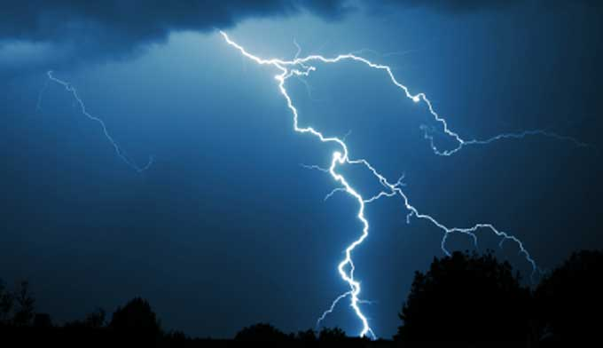
Developing a Learning Activity Example 2 - Theatre
Blow, winds, and crack your cheeks! Rage, blow!
You cataracts and hurricanoes, spout
Till you have drench’d our steeples, drown’d the cocks!
You sulph’rous and though-executing fires,
Vaunt-couriers of all-cleaving thunderbolts,
Singe my white head! And thou, all shaking thunder,
Strike flat the thick rotundity o’ th’ world!
Crack nature’s moulds, all germains spill at once
That make ingrateful man!
Rumble thy bellyful! Spit, fire! Spout, rain!
Nor rain, wind, thunder, fire are my daughters.
I tax not you, you elements, with unkindness,
I never gave you kingdom, call’d you children,
You owe me no subscription. Then let fall
Your horrible pleasure. Here I stand your slave,
A poor, infirm, weak, and despis’d old man;
But yet I call you servile ministers,
That will with two pernicious daughters join
Your high-engender’d battles ‘gainst a head
So old and white as this. O, ho! ‘tis foul.
(King Lear by William Shakespeare, Act 3, Scene 2)
Notes:
.

Slide 170
Developing a Learning Activity Example 2 - Theatre
Shannon and Nonno turn and face toward the storm, like brave men facing a firing squad. Maxine is excitedly giving orders to the boys.
The German party look on the storm as a Wagnerian climax. They rise from their table as the boys come to clear it and start singing exultantly. The storm, with its white convulsions of light, is like a giant white bird attacking the hilltop of the Costa Verde. Hannah reappears with her water colors clutched against her chest.
[Shannon] moves away from the wall to the edge of the verandah as a fine silver sheet of rain descends off the sloping roof, catching the light and dimming the figures behind it. Now everything is silver, delicately lustrous. Shannon extends his hands under the rainfall, turning them in it as if to cool them. Then he cups them to catch the water in his palms and bathes his forehead with it. The rainfall increases. The sound of the marimba band at the beach cantina is brought up the hill by the wind. Shannon lowers his hands from his burning forehead and stretches them out through the rain’s silver sheet as if he were reaching for something outside and beyond himself. Then nothing is visible but these reaching-out hands. A pure white flash of lightning reveals Hannah and Nonno against the wall, behind Shannon, and the electric globe suspended from the roof goes out, the power extinguished by the storm. A clear shaft of light stays on Shannon’s reaching-out hands till the stage curtain has fallen, slowly.
Note: In staging, the plastic elements should be restrained so that they don’t take precedence over the more important human values. It should not seem like an “effect curtain.” The faint, windy music of the marimba band from the cantina should continue as the houselights are brought up for the intermission.
(Stage directions from The Night of the Iguana by Tennessee Williams)
Notes:
.

Slide 171
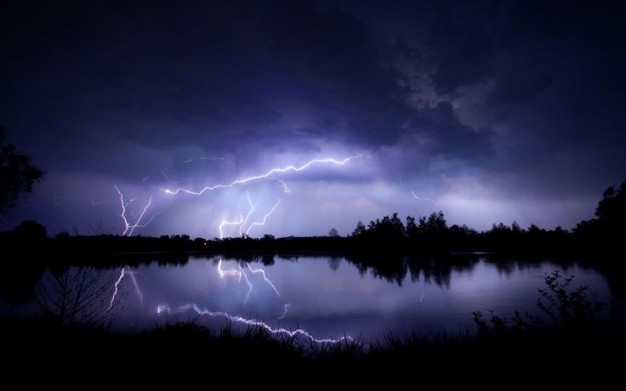
Developing a Learning Activity Example 2 - Theatre
Thunder cracks. The women work over Rose of Sharon, and the rain drums down. Pa jumps in the water and drives his shovel into the mud. The other men do the same.
Rose of Sharon screams over the thunder. The men begin to pile sandbags along the bank of the stream.
A terrific crack and a flash of lightning. A ripping crash tears the air. It is the sound of a great cottonwood toppling. The men stop to look out, their mouths open. They watch the great tree split and thunder into the boiling stream.
Uncle John takes the shovel and slips out the door. Thunder. He comes down to the trough of water and puts his shovel down. Holding the box [containing the stillborn baby] in front of him, he edges into the swift stream. Thunder. For a time he stands watching the water swirl by, leaving its yellow foam among the willow stems. He holds the apple box against his chest. And then he leans over and sets the box in the stream and steadies it with his hand.
[Uncle John] guides the box gently out in to the current and lets it go, then grabs the shovel and returns to the boxcar. The rain is now a gentle drizzle.
(Stage directions from The Grapes of Wrath by Frank Galati)
Notes:
.

Slide 172
Developing a Learning Activity Example 2 - Theatre
Much can be said about how the storm is characterized in each of these plays. Note, though, that this is what is taking place—the storm takes on the role of another character in the play.
“Rumble thy bellyful!”
“servile ministers that will with two pernicious daughters join”
“like brave men facing a firing squad.”
“like a giant white bird attacking the hilltop”
“the rain drums down”
“A ripping crash tears the air.”
Notes:
.

Slide 173
Developing a Learning Activity Example 2 - Theatre
Now consider how Francis also characterized creation.
Praised be You, my Lord through Brother Wind, and through the air, cloudy and serene, and every kind of weather, through whom You give sustenance to Your creatures.
The Canticle of the Creatures
Notes:
.

Slide 174
Developing a Learning Activity Example 2 - Theatre
How can a view of natural elements as fellow creatures (brother, sister) affect our experience of nature?
How do the human characters in the play respond to or interact with natural elements that are “mere” physical phenomena?
Is there anything “behind” nature?
Notes:
.

Slide 175
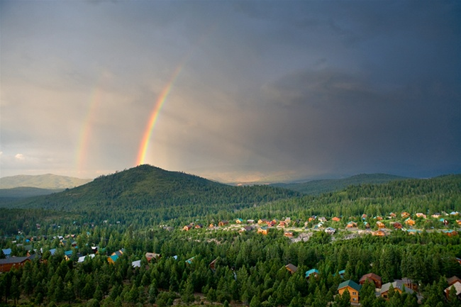
Developing a Learning Activity Example 2 - Theatre
When the Word is uttered in time, the canvas of creation unfolds. The triune God is then revealed as a divine Artist, and creation is the finite expression of the Artist’s infinite ideas.
As a work of art, creation is intended to manifest the glory of the Artist-Creator.
(Ilia Delio, Simply Bonaventure)
Notes:
.

Slide 176
Developing Learning Activities
If you’d like some guidance on how the FIT might be applied to your own discipline, you might consult the articles listed here:
http://franciscancollegesuniversities.org/resources/discipline-specific-resources/
These might give you some lines along which you might develop your own learning activities.

Slide 177
Developing Learning Activities
You might also view these videos about utilizing the FIT in specific disciplines:
Communications: https://www.youtube.com/watch?v=0w7zxGK73_A&feature=youtu.be
Religious Studies: https://www.youtube.com/watch?v=kbzhfBmRxJs
Philosophy: https://www.youtube.com/watch?v=kb8nEzTWR94

Slide 178
Moving Forward
We hope you have found this course beneficial and that you will find the material useful in incorporating the Franciscan Intellectual Tradition into your teaching.
We would be interested in your feedback about the course. You can access a brief survey about the course here: Survey of FIT in your course
Again, if you have questions about the course or next steps, you can send an email to afcu@felician.edu.
178

