Slide 1
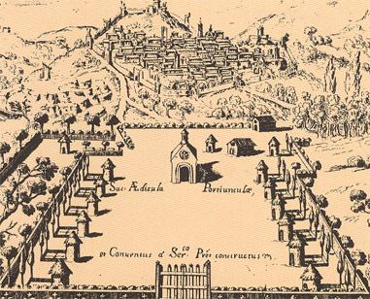
Community
COMMUNITY WITHIN
THE FRANCISCAN TRADITION

Slide 2
Community
The questions
How can we integrate into our academic programs the Franciscan Intellectual Tradition?
How can we be confident in our knowledge of the roots of the Franciscan tradition so that we can effectively incorporate that knowledge in our curriculum and activities at ___________?

Slide 3
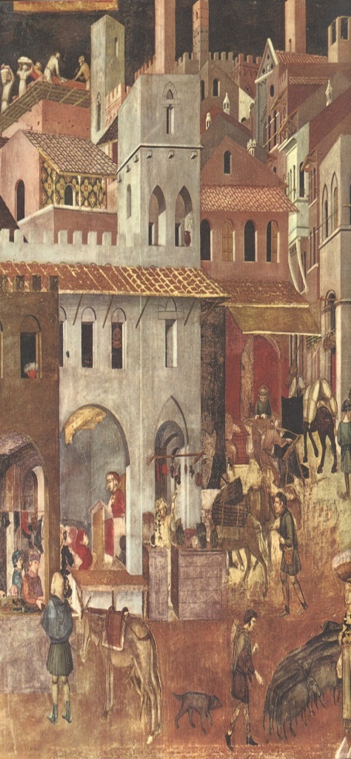
Community
Social Structure in Assisi in the 13th Century
Maiores | Minores | Serfs
nobles | laborers | slaves to the land/master
knights | artists merchants | lived outside city walls
boni uomini | “freemen” | had no money
paid no taxes | paid taxes
obliged to protect the minores

Slide 4
Community
4
Elements of the Charism Lived
by Francis and Clare:
Belief that God is totally self-giving
Rooted in the primacy of Christ
Affirms always the dignity of the human person
Builds Community/Relationship
Acts with reverence for creation/creatures
Mends ruptures
Service

Slide 5
Community
5
Monasticism in Contrast with Francis’s Mendicant Movement
Monasticism required withdrawal from the world and society to find God in an enclosed society.
Francis found God by living in society
Related more to the serfs than the maiores, yet rejected a class structure.
Community was necessary, less for economic security than true fraternity.

Slide 6
Community
6
Francis and Community
Francis did not start out to form a community but to live the life of a penitent.
Others joined him: “a certain man of Assisi,” Bernard, Peter, Giles, Philip
They were all lesser brothers—Friars Minor

Slide 7
Community
7
Relationships of the Brothers
“Let them behave among themselves according to what the Lord says: Do to others what you would have them do to you.” (The Earlier Rule, IV, 4)
“Let the ministers and servants remember what the Lord says: I have not come to be served, but to serve; and because the care of the brothers’ souls has been entrusted to them, if anything is lost on account of their fault or bad example, they will have to render an account before the Lord Jesus Christ on the day of judgment.” (The Earlier Rule, IV, 6)
The life of the community was exhibited in their sharing at Rivo Torto; each had a place.
Notes:
Texts:
Armstrong, Regis J., Hellman, J. A. Wayne, & Short, William J., eds. Francis of Assisi: Early Documents. Three Volumes. New York/London/Manila: New City Press, 1999-2001, Volume 1:66
Francis of Assisi: Early Documents, Volume 1:66-67.

Slide 8
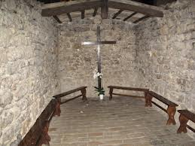
Community
Rivo Torto — Sharing
Community was exemplified in sharing a small space with each assigned a spot to sleep.
8
Notes:
It served as a shelter for the peasants and is beside a small winding stream, in Italian a “Rivo Torto”.
When the Lord gave Francis some Brothers, that is to say, from 1208, the entire young fraternity lived here. Rivo Torto is, therefore, the place of the first fraternal experiences, the place where the itinerant Brothers came together before they went to settle at the Portiuncula in 1210.

Slide 9
Community
The Community’s Relationships based on Relationship to Jesus
“They are children of the heavenly Father Whose works they do, and they are spouses, brothers and mothers of our Lord Jesus Christ.” (The First Letter to the Faithful, 7)
Applies to all brothers
Spouses — joined to Jesus in the Spirit
Brothers — doing the will of the Father
Mothers — give birth to Jesus through holy activity
9
Notes:
Francis of Assisi: Early Documents, Volume 1:41-42

Slide 10
Community
10
Francis and the Larger Community
Francis’s form of community was different from that of monasticism.
It was in relationship to the larger world.
“[Lady Poverty] rose and asked to be shown the enclosure. Taking her to a certain hill, they showed her all the world they could see and said: ‘This, Lady, is our enclosure.’” (The Sacred Exchange between St. Francis and Lady Poverty, 63)
Notes:
Francis of Assisi: Early Documents, Volume 1:552.

Slide 11
Community
11
Service of the Ministers
Regula non bullata
“Let all the brothers who have been designated the ministers and servants of the other brothers . . . frequently visit, admonish and encourage them spiritually.’” (The Earlier Rule, IV, 2)
Notes:
Francis of Assisi: Early Documents, Volume 1:66

Slide 12
Community
12
Clare and Community
[Clare’s] life was an instruction and a lesson to others: in this book of life. (The Papal Decree of Canonization ¶ 14)
She set the example for the sisters.
- Caring for those who were ill
- Being willing to beg for their needs
Notes:
Armstrong, Regis J., ed. Clare of Assisi: Early Documents. New York: New City Press, 2006:267

Slide 13
Community
13
Clare and the Sick Sisters
“Let the abbess be strictly bound to inquire with diligence, by herself and through other sisters, what their illness requires both by way of counsel as well as good and other necessities . . . For if a mother loves and cares for her child according to the flesh, how much more attentively should a sister love and care for her sister according to the Spirit?”
(The Form of Life of Saint Clare VIII, 12, 16)
Notes:
Clare of Assisi: Early Documents:120-121

Slide 14
Community
14
Clare and Her Sisters
“Let the abbess, on her part, be so familiar with them that they can speak speak and act with her as ladies do with their handmaid. For this is the way it must be: the abbess should be the handmaid of all the sisters.
(The Form of Life of Saint Clare X, 4)
Notes:
Clare of Assisi: Early Documents:123

Slide 15
Community
15
Clare and the Larger Community
The sick came to the monastery to be healed.
Others came to bring alms or to receive spiritual consolation.
Many Poor Clares went to other Poor Clare communities to help them in their formation.

Slide 16
Community
16
Enclosure and the Wider Community
Clare believed that enclosure and the observance of poverty was for the sake of the Church.
“The Lord himself has placed us as a model, as an example and mirror not only for others, but also for our sisters whom the Lord has called to our way of life as well, that they in turn might be a mirror and example to those living in the world.” (The Testament 19-20)
Notes:
Clare of Assisi: Early Documents:61

Slide 17
Community
17
Transfer to Academic Life for Us Today
Creating a caring community
Respecting each person’s dignity
Offering hospitality, courtesy, kindness and friendship
“Working together in unity of mind and heart, in shared decision making with respect to the way they wanted to live, and in mutual charity, each willing to look out for the needs of another.”

Slide 18
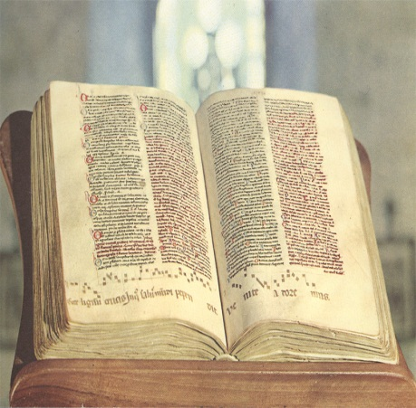
Community
Does Community = Collegiality?
How Francis Described the Perfect Brother
Blessed Francis used to say that a good Lesser Brother is one who would possess the life and qualities of the following … brothers: the faith and love of poverty [of] Brother Bernard; the simplicity and purity … of Brother Leo; the courtly bearing of Brother Angelo who … was endowed with every courtesy and kindness; the friendly manner and common sense of Brother Masseo, together with his attractive and gracious eloquence; … the mind raised in eloquence [of] Brother Giles; … the virtuous and constant prayer of Brother Ruffino; … the patience of Brother Juniper, who achieved the perfect state of patience because he always kept in mind the perfect truth of his low estate; … the bodily and spiritual strength of Brother John of Lauds; … the charity of Brother Roger whose life and conduct were spent in ardent love; the solicitude of Brother Lucidus who had the greatest care and concern….
18
Notes:
This passage appears in A Collection of Sayings of the Companions of Blessed Francis (Francis of Assisi: Early Documents, Volume 3:125 and in A Mirror of the Perfection, Chapter V, 85 (Francis of Assisi: Early Documents, Volume 3:333).

Slide 19
Community
19
Discussion Questions
What are the qualities of relationship in my life? my work?
Are the relationship skills we use horizontal or hierarchical?
How should we address the presence/absence of Franciscan and Christian principles in our teaching?
How do we ask one another to be responsible for the ways in which we use our gifts and our capacity to care about our students and their futures?

