Slide 1
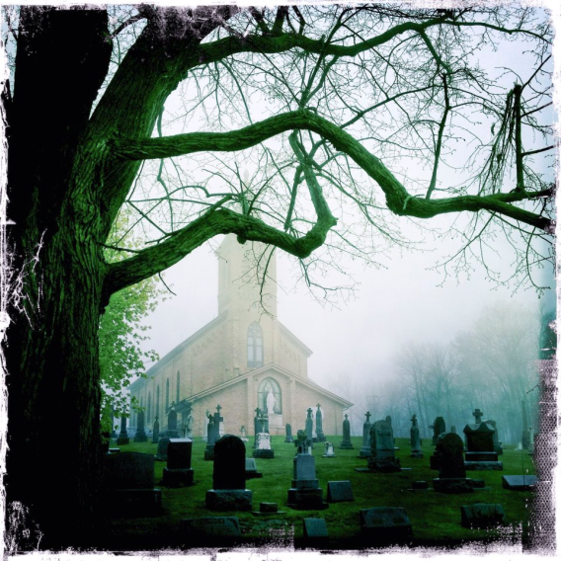
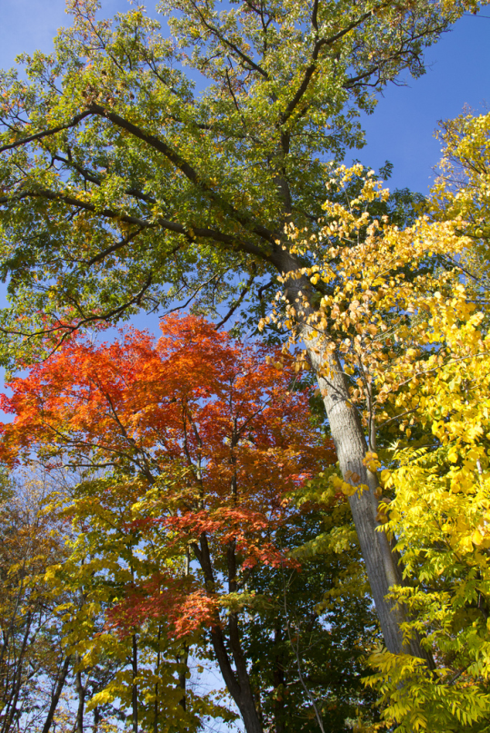
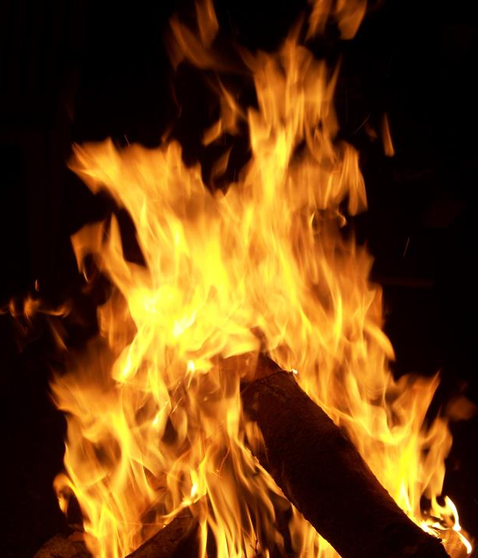
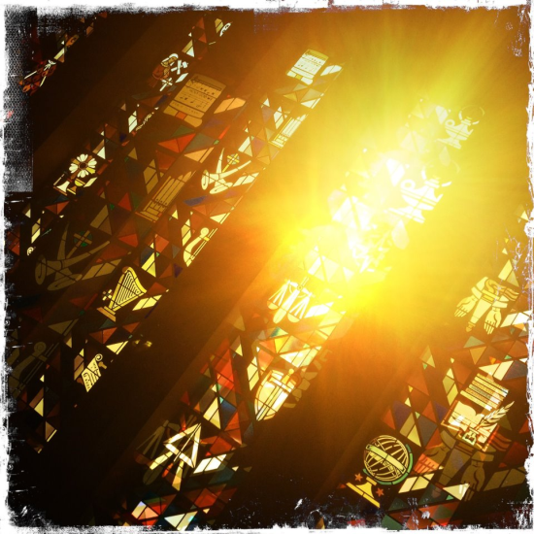
In the Franciscan Tradition
Creation

Slide 2
This world is pregnant with God.
Creation
Angela of Foligno 13th Century Franciscan and Mystic

Slide 3
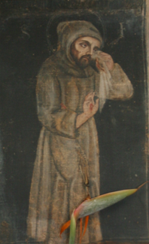
Francis of Assisi
Creation
Patron of Ecology or Ecological Literacy by Pope John Paul II – 1979
Special relationship with creation - Respect

Slide 4
Creation
Special Relationship of Respect
That the bees not perish of hunger in the icy winter, [Francis] commands that honey and the finest wine should be set out for them. . . . He calls all animals by a fraternal name.
(Thomas of Celano, Remembrance of the Desire of a Soul, The Second Book, 165)
Notes:
Armstrong, Regis J., Hellman, J. A. Wayne, & Short, William J., eds. Francis of Assisi: Early Documents. Three Volumes. New York/London/Manila: New City Press, 1999-2001, Volume 2:354

Slide 5
Creation
Why this respect?
Even for worms he had a warm love, since he had read this text about the Savior: I am a worm and not a man. That is why he used to pick them up from the road and put them in a safe place so that they would not be crushed by the footsteps of passersby.
(Thomas of Celano, The Life of Saint Francis, The First Book, XXIX, 80)
Notes:
Francis of Assisi: Early Documents, Volume 1:250

Slide 6
Why this respect?
Creation
Francis experienced
JESUS CHRIST
in the world around him.
Jesus manifested God.

Slide 7
Creation
Aroused by everything to divine love,
he rejoiced in all the works of the Lord’s hands, and through their delightful display he rose into their life-giving reason and cause.
(Bonaventure, The Major Legend of Saint Francis, IX, 1)
Notes:
Francis of Assisi: Early Documents, Volume 2:596

Slide 8
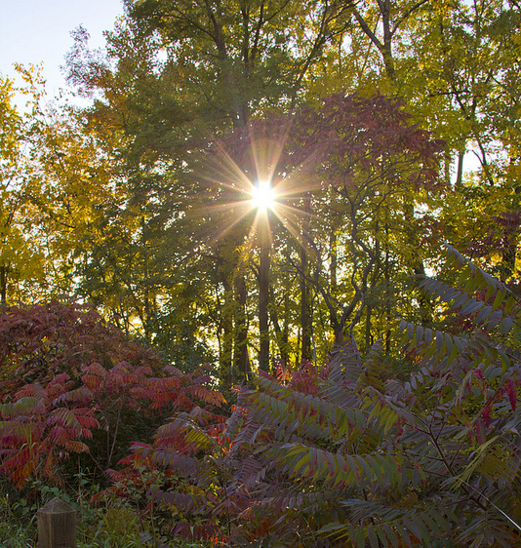
Creation
In beautiful things he contuited Beauty itself,
(Bonaventure, The Major Legend
of Saint Francis, IX, 1)
and through the footprints impressed in things he followed his Beloved everywhere;
out of them all making for himself a ladder through which he could climb up to lay hold of him who is utterly desirable.
Notes:
Francis of Assisi: Early Documents, Volume 2:596
The note for the text explains: “The Latin word, contuitus, is used nine times by Bonaventure in LMj,, and can be translated as “concomitant gaze or insight.” [Francis of Assisi: Early Documents, Volume 2:532d]

Slide 9
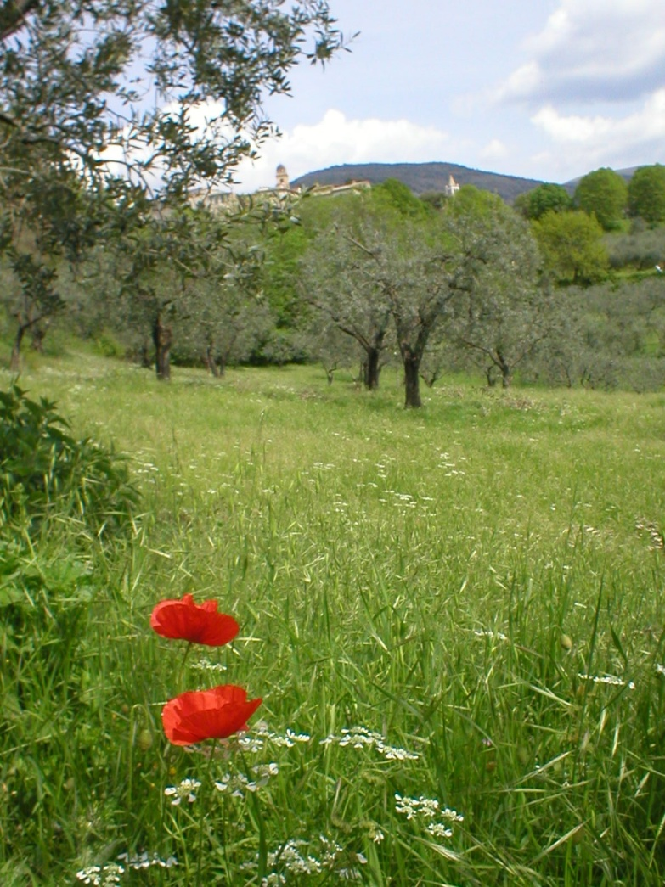
Creation
Presence of the Author of Creation

Slide 10
Creation
GOD IS TOTALLY SELF-GIVING
the abundance of God ▼
goodness overflows
▼
source of creation
▼
creation is good

Slide 11
Creation
You, Lord, are Supreme Good, the Eternal Good, from Whom all good comes without Whom there is no good.
(Francis of Assisi, A Prayer Inspired by the Our Father, 2)
Notes:
Francis of Assisi: Early Documents, Volume 1:158

Slide 12
Creation
All powerful, most holy, most high, supreme God: all good, supreme good, totally good, You Who alone are good, may we give You all praise, all glory, all thanks, all honor, all blessing, and all good.
So be it! So be it!
(Francis of Assisi, The Praises to Be Said at All the Hours, 11)
Notes:
Francis of Assisi: Early Documents, Volume 1:162

Slide 13
Bonaventure of Bagnoregio
Creation
Doctor of the Church
Creation : the external expression of God’s love
The Word-Become-Flesh: the inner expression of God

Slide 14
Creation
To say that creation flows out of the infinite fountain of divine self-diffusive goodness is to say that God is creative and loving.
The Word … is the Art of the Father because the Word expresses all the divine ideas (of the Father).
(Ilia Delio, Simply Bonaventure)
Notes:
Ilia Delio, Simply Bonaventure: An Introduction to His Life, Thought, and Writings, New York: New City Press, 2001:55

Slide 15
Creation
When the Word is uttered in time, the canvas of creation unfolds. The triune God is then revealed as a divine Artist, and creation is the finite expression of the Artist’s infinite ideas.
As a work of art, creation is intended to manifest the glory of the Artist-Creator.
(Ilia Delio, Simply Bonaventure)
Notes:
Ilia Delio, Simply Bonaventure: An Introduction to His Life, Thought, and Writings:55

Slide 16
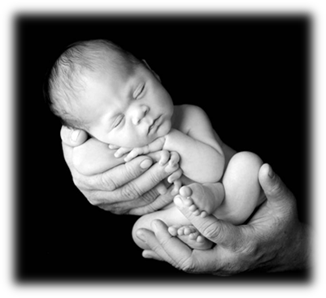
INCARNATION
Creation
Primary reason for respect for the created world
▼
The WORD takes on a human nature and participates in everyday life.

Slide 17
John Duns Scotus Franciscan theologian
Creation
From the beginning of creation, God’s intent was to enter into a relationship with the created world.
God’s self-expression
Love incarnated in Jesus
Motivation: love not sin

Slide 18
Primacy of Jesus
Creation
God’s self-revelation through Jesus resulted in the creation of the universe.
In the beginning was the Word, and the Word was with God, and the Word was God. He was in the beginning with God. All things came to be through him, and without him nothing came to be. What came to be through him was life…
(John 1: 1-4a)

Slide 19
Haecceitas “thisness”
Creation
Countless varieties in creation
▼
Reflection of diversity in God
Uniquely and singularly created by God
Individualized Tom is Tom and not Bill.

Slide 20
Singular Significance
Creation
God’s explicit decision to create each entity
► Inherent dignity
► Common Source of existence
► Image and likeness of God

Slide 21
Singular Significance
Creation
Consider, O human being, in what great excellence the Lord God has placed you, for He created and formed you to the image of His beloved Son according to the body and to His likeness according to the Spirit.
(Francis of Assisi, Admonition V)
Notes:
Francis of Assisi: Early Documents, Volume 1:131

Slide 22
Interconnectedness of Life
Creation
Maturation of singular significance:
Equal before God
► Outcast, rich, poor, Christian, Moslem, holy, sinful
► Animals, plants, animate and inanimate

Slide 23
Interconnectedness of Life
Creation
If you have men who will exclude any of God’s creatures from the shelter of compassion and pity, you will have men who deal likewise with their fellow men.
Francis of Assisi

Slide 24
The Canticle of the Creatures
Creation
One of the earliest Italian poems written in the Umbrian dialect
From the depths of a mystic
Composed near the end of his life

Slide 25
The Canticle of the Creatures
Creation
Reveals the relationship of Francis with God, Jesus Christ, and the world, inanimate and animate, human and other living creatures
Creation – a place of praise and presence of God

Slide 26
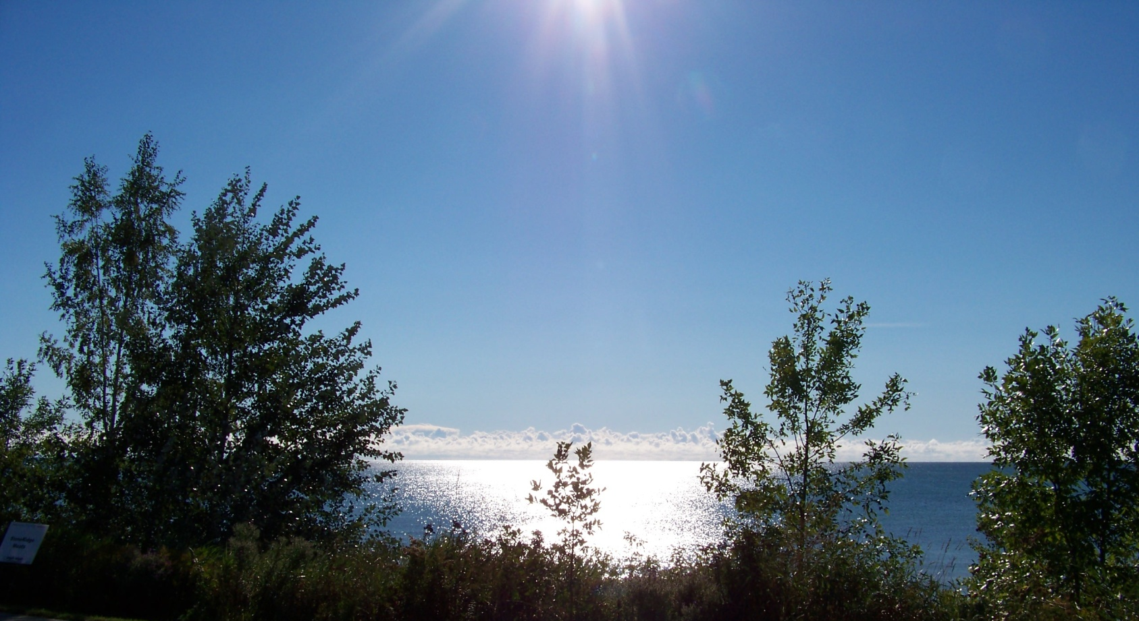
The Canticle of the Creatures
Creation
Begins with praise to the “Most High”
Most High, all-powerful, good Lord, Yours are the praises, the glory, the honor, and all blessing, To You alone, Most High, do they belong.

Slide 27
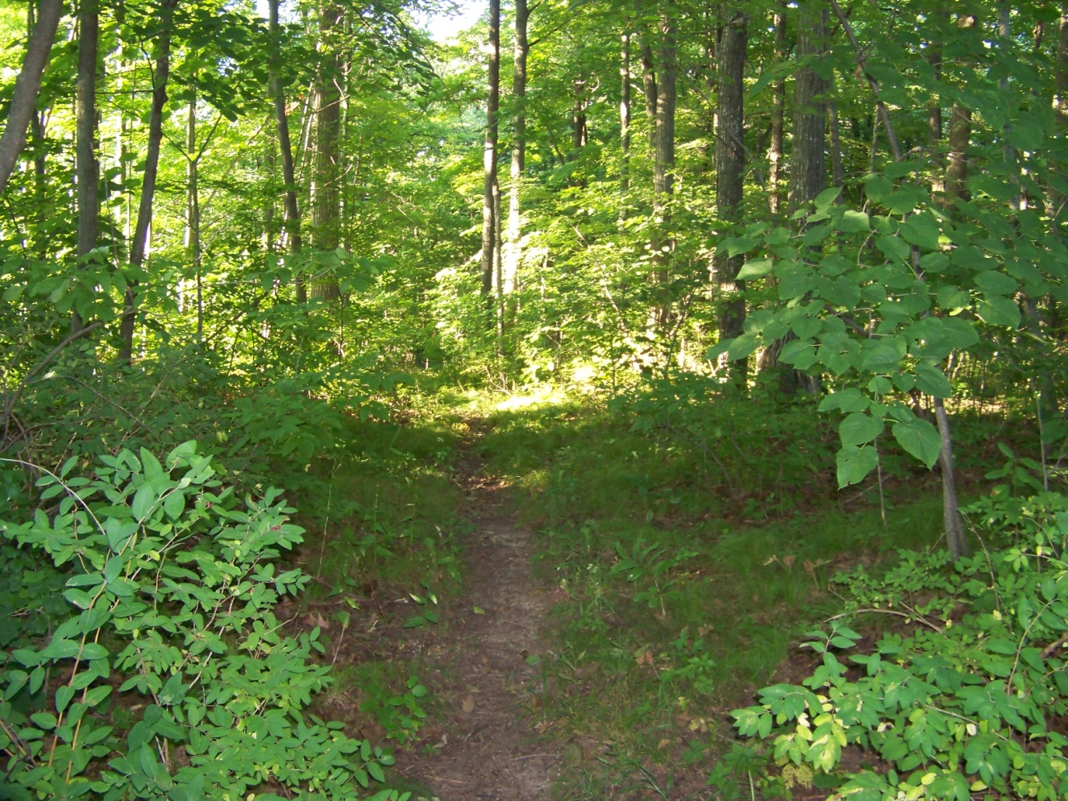
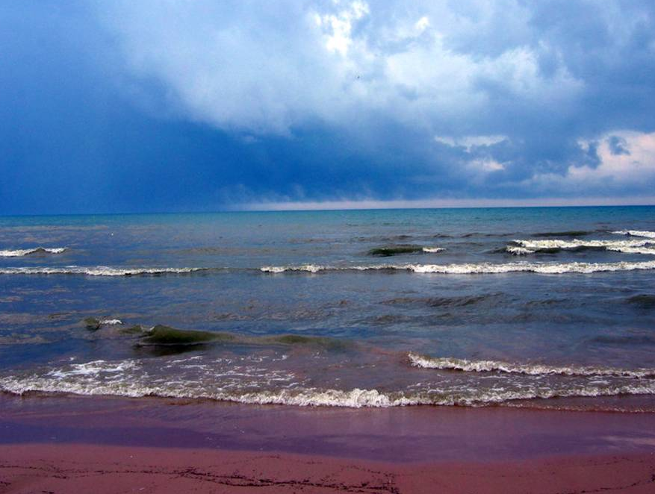
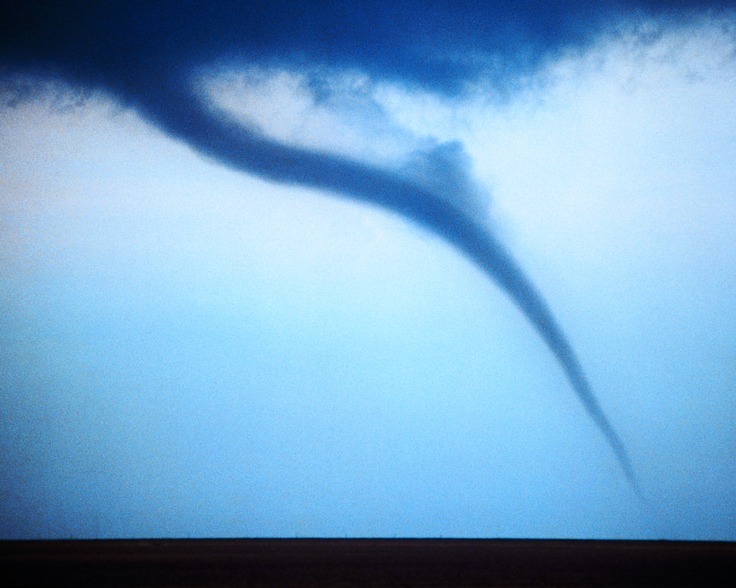
The Canticle of the Creatures
Creation
Moves through the bodies of light, then
Four basic elements of the universe: air, water, fire, earth
Natural harmony and interconnectedness exist in their world

Slide 28
The Canticle of the Creatures
Creation
With the creation of humans, discord enters.
Praised be to You, my Lord, through those who give pardon for Your love, and bear infirmity and tribulation. Blessed are those who endure in peace for by You, Most High, shall they be crowned.

Slide 29
The Canticle of the Creatures
Creation
Integration of every creature and experience with Francis’s welcoming Sister Death
Praised be You, my Lord, through our Sister Bodily Death, … Blessed are those whom death will find in Your most holy will…

Slide 30
The Canticle of the Creatures
Creation
Francis comes full circle
returning to praise.
Praise and bless my Lord and give Him thanks and serve Him with great humility.

Slide 31
The Canticle of the Creatures
Creation
Francis intertwines his understanding of God’s self-revelation through Jesus.
The Creator, “Most High,” empties, strips, becomes human and “serve(s) … with great humility.”

Slide 32
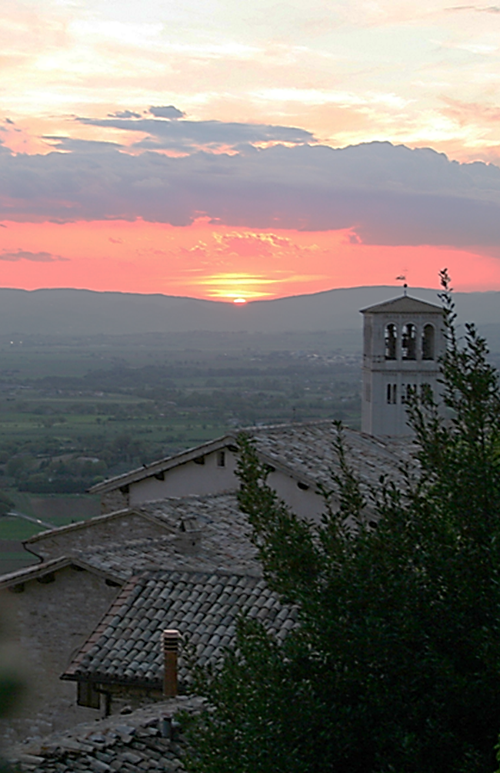
The CANTICLE OF the Creatures
Most High, all-powerful, good Lord, Yours are the praises, the glory, and the honor, and all blessing, To You alone, Most High, do they belong, and no human is worthy to mention Your name.
Praised be You, my Lord, with all Your creatures, especially Sir Brother Sun, Who is the day and through whom You give us light. And he is beautiful and radiant with great splendor; and bears a likeness of You, Most High One.
Notes:
Francis of Assisi: Early Documents. Volume 1:113-114

Slide 33
Praised be You, my Lord,
through Sister Moon and the stars, in heaven You formed them clear and precious and beautiful.
Praised be You, my Lord through Brother Wind, and through the air, cloudy and serene, and every kind of weather, through whom You give sustenance to Your creatures.
Praised be You, my Lord, through Sister Water, who is very useful and humble and precious and chaste.
Praised be You, my Lord, through Brother Fire through whom You light the night, and he is beautiful and playful and robust and strong.
Notes:
Francis of Assisi: Early Documents. Volume 1:113-114

Slide 34
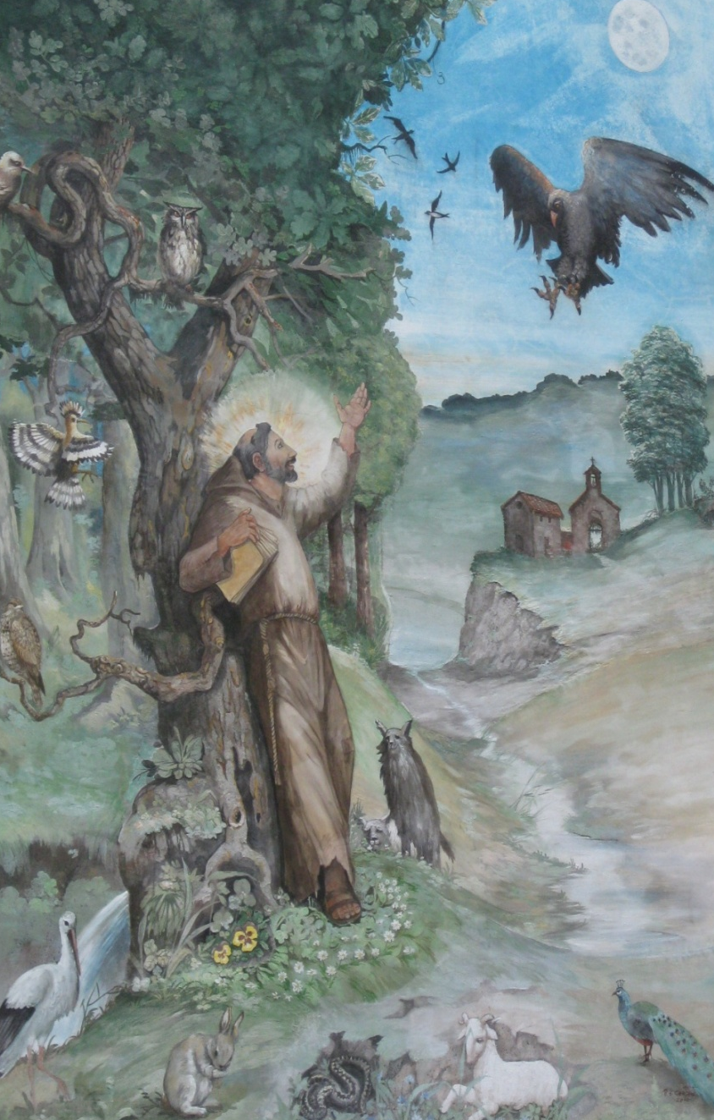
Praised be You, my Lord,
through our Sister Mother Earth, who sustains and governs us, and who produces various fruit with colored flowers and herbs
Praised be You, my Lord, through those who give pardon for Your love, and bear infirmity and tribulation. Blessed are those who endure in peace for by You, Most High, shall they be crowned.
Praised be You, my Lord, through our Sister Bodily Death, from whom no one living can escape. Woe to those who die in mortal sin. Blessed are those whom death will find in Your most holy will, for the second death shall do them no harm.
Notes:
Francis of Assisi: Early Documents. Volume 1:113-114

Slide 35
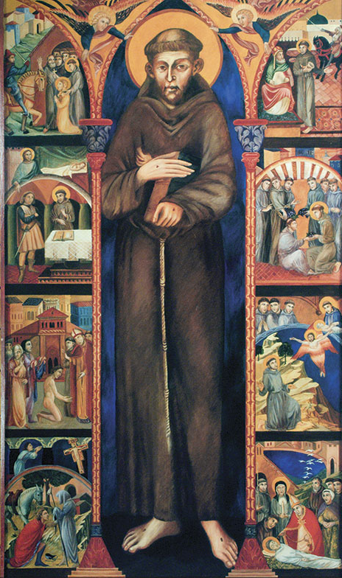
Praise and bless my Lord and give Him thanks and serve Him with great humility.
Notes:
Francis of Assisi: Early Documents. Volume 1:113-114

Slide 36
Environment
What solid theological and Christological principles can environmental decisions be based upon?

Slide 37
Environment
Creation
Rights of creation
→ unique and individuated
Own existence determines
→ their value and
→ their right to be what each was created to be

Slide 38
Matter does matter.
Creation
Familial mode of relating to creation
Intrinsic goodness and value of all of creation
Sacramentality of creation
Acknowledgement of the effects of our sinful behavior

Slide 39
Matter does matter.
Creation
Biological diversity
Interdependence of all that exists
The common good

Slide 40
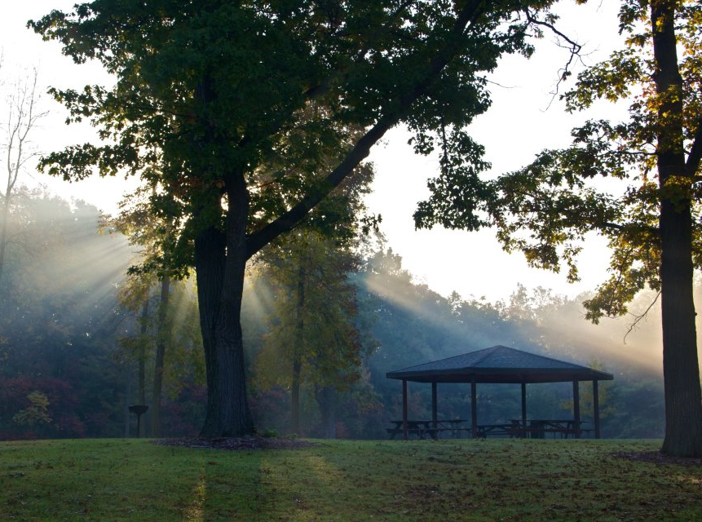
TRULY “This world is pregnant with God.”
Angela of Foligno

Slide 41
Discussion Questions
Creation
1. How can we encourage the belief of the centrality of creation in making God known to humanity?

Slide 42
Discussion Questions
Creation
2. Creation became as a ladder on which Francis became more immersed in God. As a Franciscan based college, we are challenged to discover traces of God in our academic disciplines. What is that ladder in your discipline?

Slide 43
Discussion Questions
Creation
3. Who benefits, and who loses, by public policy that does not protect the environment?

Slide 44
Discussion Questions
Creation
4. We are a consumer-driven society defined by its usefulness and profitability. What steps can be taken to support a child-of-God or a kin-with-creation approach?

Slide 45
Discussion Questions
Creation
5. When Francis went to live among the lepers, these people were not the marginalized or outcasts of his society. They were not just excluded from their society. They were non-persons. They had no name, no voice, no benefits, no existence.

Slide 46
Discussion Questions
Creation
5. What role does the Franciscan spirituality have, especially in Franciscan institutions of higher learning, in being brother or sister to the “no people” social class of our time?

Slide 47
Prayer
Creation
God of overflowing goodness, since time began you have been revealing yourself in all creation. From the Big Bang to the convergence of galaxies, from the distant stars to this Earth, which is our home, you have never ceased shaping and fashioning us, urging us toward life.
(Ilia Delio)
Notes:
Ilia Delio, Compassion: Living in the Spirit of St. Francis, Cincinnati: St. Anthony Messenger Press, 2011:127

Slide 48
Creation
We are truly amazed at the work of your hands and for the life of Jesus, who reflects your radiance. We are blessed by the gift of self-awareness that you have given to us. Help us to be mindful that we are the universe conscious of itself and that we are sister and brother to all creation.
(Ilia Delio)
Notes:
Ilia Delio, O.F.M., Compassion: Living in the Spirit of St. Francis:127

Slide 49
Creation
Open our hearts to receive the gift of life that comes to us each day from the sun, the stars, plant life, animal life, and the unique giftedness of each human person. Lead us kindly on this cosmic journey that we may become the fullness of Christ who is our peace. Amen.
(Ilia Delio)
Notes:
Ilia Delio, Compassion: Living in the Spirit of St. Francis:127

Slide 50
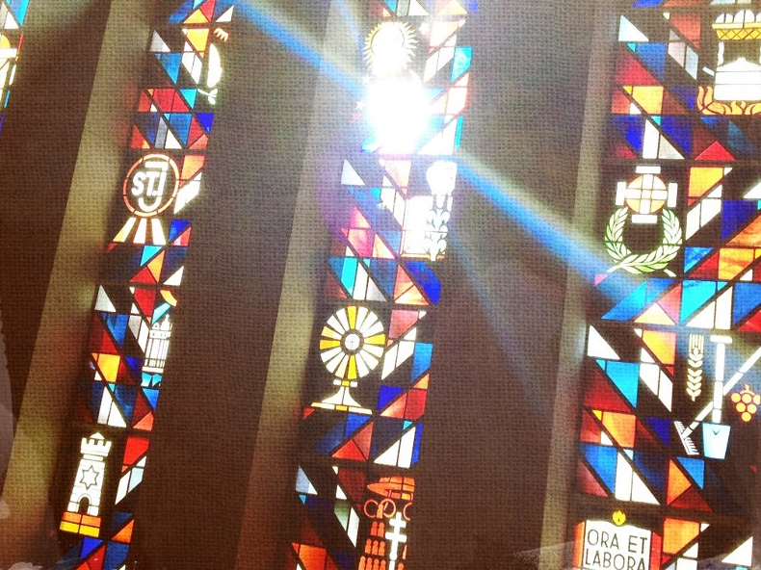
Silver Lake College of the Holy Family Chapel

