Slide 1
FRANCISCAN PEACEMAKING

Slide 2
Franciscan Peacemaking
Peacemaking with a Franciscan Lens
Admonition 27:
1. Where there is charity and wisdom, there is neither fear nor ignorance.
2. Where there is patience and humility, there is neither anger nor disturbance.
3. Where there is poverty with joy, there is neither covetousness nor avarice.
Notes:
Francis of Assisi: Early Documents, Volume 1:136-137

Slide 3
Franciscan Peacemaking
4. Where there is inner peace and meditation, there is neither anxiousness nor dissipation.
5. Where there is fear of the Lord to guard the house (cf. Lk. 11:21), there the enemy cannot gain entry.
6. Where there is mercy and discernment, there is neither excess nor hardness of heart.
Notes:
Francis of Assisi: Early Documents, Volume 1:136-137

Slide 4
Franciscan Peacemaking
Peacemaking Virtues
The Admonitions are exhortations to embrace what gives life (the Gospel virtues) and to avoid what stifles or chokes off life within oneself and others (the vices).
Admonition 27 summarizes the Gospel virtues that counteract the vices - the desires of the flesh/the world - which seduce and delude one into a false sense of self, which fracture and wound relationships, and which rob and deprive one of inner peace.
Notes:
It is difficult to determine the circumstances and dates of their composition. They were most likely delivered by St. Francis at friar gatherings, such as the Chapter Mats or Pentecost Chapters.

Slide 5
Franciscan Peacemaking
Peacemaking Virtues
The virtues bring healing and peace to one’s human spirit.
They influence and transforms one’s words and deeds so that they are spirit and life for others.
These Gospel virtues are essential to Franciscan peacemaking; that is, within oneself, with others, God and creation.

Slide 6
Franciscan Peacemaking
Peacemaking is a core value of the Franciscan Charism. Franciscans are to be peacemakers.
Peacemaking emerges from Francis’s own cultural, social and historical reality.
Conflict between the rising Merchant Class and the Nobility (Break down of the Feudal System)
Conflict between the Pope and the Holy Roman Emperor
The Crusades
Medieval Chivalry and Knighthood
A Culture of Vendetta
Notes:
The Italian vendettas, or blood-feuds, were a long-standing tradition that most cities and towns tried to break. It was a difficult task since, by Italian standards, the honor of a family required that adequate vengeance be sought for the injury or death of a family member. The act of vengeance placed a similar burden on the newly bereaved family and the feud was perpetuated. Unfortunately, innocent bystanders could often be killed or injured and many laws were enacted in an attempt to reduce the violence of vendettas. Funerals, often held at night throughout the Middle Ages, were restricted to daylight hours in the fourteenth and fifteenth centuries. The gathering of large family groups and the cover of darkness were too convenient for the perpetuation of feuds. Lorenzo de Medici was himself injured and his brother, Giuliano, was killed in an attack by a rival family in fifteenth century Florence. The vendettas and family feuds of Italy were well-known throughout Europe. Shakespeare used two feuding families in Verona, the Montecchi and Cappelo families, as the models for the Montague and Capulet families of his tragic play, Romeo and Juliet.

Slide 7
Franciscan Peacemaking
Significant Events in Francis’s early life which influenced his understanding of violence and peace.
- Prisoner of War (POW)
- Sickness (Post Traumatic Stress Syndrome, Malaria)
- Dream at Spoleto (The Legend of the Three Companions, II, 6; Thomas of Celano, The Remembrance of the Desire of a Soul, The First Book, II, 6; Bonaventure, The Major Legend of Saint Francis, I, 3)

Slide 8
Franciscan Peacemaking
Significant Events in Francis’s early life which influenced his understanding of violence and peace.
- Kissing the Leper (The Testament; Bonaventure, The Major Legend of Saint Francis, I, 5)
- Hearing the voice of Christ from the San Damiano Cross: “Go repair my house…” (Bonaventure, The Major Legend of Saint Francis, II, 1)
- Gospel of Luke 10:1-9 on the Feast of St. Matthias at the Portiuncula. [Changes the belt on his penitent’s habit and begins to preach penance.] (Celano The Life of Saint Francis, The First Book, IX, 22; Bonaventure, The Major Legend of Saint Francis, III, 1)

Slide 9
Franciscan Peacemaking
Francis called the brothers to be at peace with one another and to preach peace by their actions and words.
I counsel, admonish and exhort my brothers in the Lord Jesus Christ not to quarrel or argue or judge others when they go about in the world; but let them be meek, peaceful, modest, gentle, and humble….Into whatever house they enter let them first say: “Peace be to this house!”
(The Later Rule, III, 10-11, 13)
Notes:
Francis of Assisi: Early Documents, Volume 1:102

Slide 10
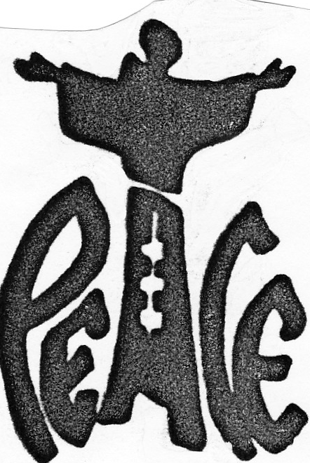
Franciscan Peacemaking
The Canticle of the Creatures
10. Praised be You, my Lord, through those who give pardon for Your Love, and bear infirmity and tribulation. 11. Blessed are those who endure in peace for by You, Most high, shall they be crowned.
N.B. Francis wrote this verse to the Canticle in response to the conflict between the Bishop of Assisi and the Mayor. (The Assisi Compilation 84)
The Testament
23. The Lord revealed a greeting to me that we should say: “May the Lord give you peace.”
Notes:
Texts:
Francis of Assisi: Early Documents, Volume 1:114
Francis of Assisi: Early Documents, Volume 2:187-188
Francis of Assisi: Early Documents, Volume 1:126

Slide 11
Franciscan Peacemaking
By walking in the footprints of the poor, humble and crucified Christ, Francis, Clare and the early Franciscan brothers and sisters learned that one overcomes violence by promoting peace and loving one another as God loves us. They recognized that we are all God’s sons and daughters since we originate from God as a special reflection of God’s goodness and beauty. Therefore, we are brothers and sisters to one another. We are members of the same family.

Slide 12
Franciscan Peacemaking
Peace with Self: Inner Peace
The basic meaning of evangelical peace is being at home with self, others, all creation, and God.
Peace With Self:
Story: Francis’s encounter with the Leper
(The Legend of the Three Companions, IV, 11; Bonaventure, The Major Legend of Saint Francis, I, 5)
Francis embraced his deepest fears and wounds.
This enabled Francis to seek solidarity with the poor and marginalized. He could now see them as his brother and sister and be at home with them.

Slide 13
Franciscan Peacemaking
Peace with Self: Inner Peace
The Testament: (Francis recalls:)
1.“for when I was in sin, it seemed too bitter for me to see lepers. 2. And the Lord Himself led me among them and I showed mercy to them. 3. And when I left them, what had seemed bitter to me was turned into sweetness of soul and body.”
Inner peace (being at home with self) only comes through facing, embracing and befriending your fears, your sinfulness and your woundedness and then allowing God’s grace to transform them into gifts and blessings (from bitterness to sweetness).
Notes:
Francis of Assisi: Early Documents, Volume 1:124

Slide 14
Franciscan Peacemaking
Peace with Others
Story: Francis’s Encounter with the Sultan. (Bonaventure, The Major Legend of Saint Francis, IX, 8)
Cognizant that the other is my/our brother or sister;
Respect and reverence for the presence of God in the other;
Openness to be touched by the other — with the possibility that one may be changed by the encounter;
Dialogue (civility in discourse) and not the sword that breaks the cycle of violence and retaliation.

Slide 15
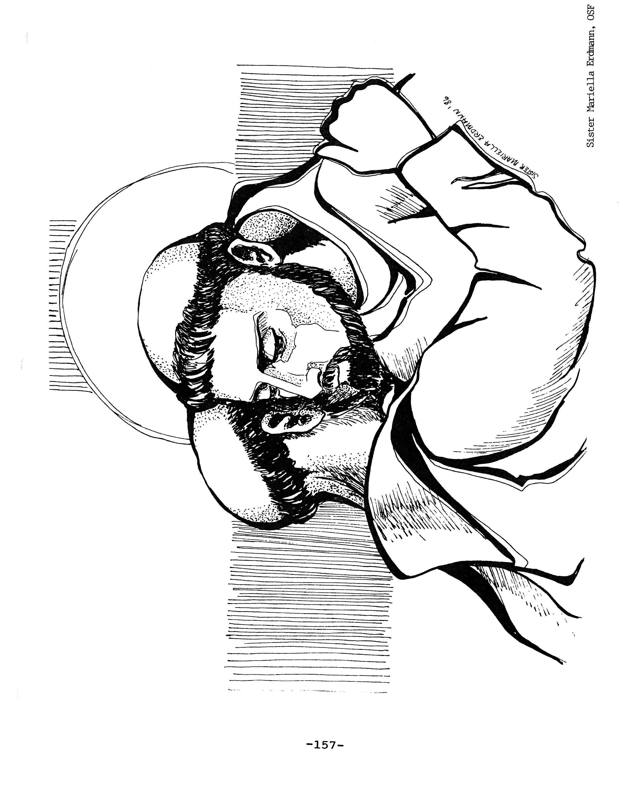
Franciscan Peacemaking
Questions:
How do I/we cultivate an openness to those around me/us?
How do I/we respect and reverence diversity, especially with regard to political ideologies, religious beliefs, cultural perspectives, etc.?
How do I/we foster and witness civility?

Slide 16
Franciscan Peacemaking
Peace with God
Story of Christmas at Greccio (Celano, The Life of Saint Francis, XXX)
Francis’s life journey was one of falling in love with God and becoming God’s love in the world.
Francis discovered the humility of God that is proclaimed through the crib, the Eucharist and the cross. They symbolize God’s unceasing love for each of us and they invite us into a loving relationship with Him and each other.

Slide 17
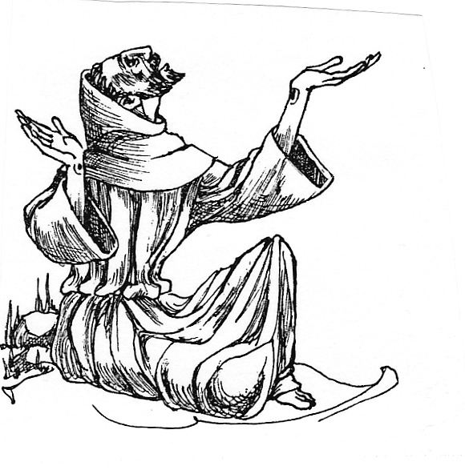
Franciscan Peacemaking
Reflective Questions:
How have I/we discovered God’s unconditional love, i.e., that God loves us in our incompleteness and brokenness, our weaknesses and failings?
How do I/we lead others to experience the mystery of God’s abundant love that will set one free from all that alienates one from love of God, self, others and all creation?

Slide 18
Franciscan Peacemaking
Wolf of Gubbio: A Lesson in Peacemaking
The story of the Wolf of Gubbio is a metaphor for peacemaking with whomever and whatever fractures being at home and interdependent with each other.
Notes:
Little Flowers of St. Francis, Chapter 21

Slide 19
Franciscan Peacemaking
Wolf of Gubbio: A Lesson in Peacemaking
The legend of St. Francis and the Wolf is found in a 14th Century book called the Fioretti or The Little Flowers of St. Francis, which was written by an anonymous Tuscan writer.
Gubbio is a village in Italy where legend has it that St. Francis of Assisi spoke with a wolf who was terrorizing the people of the village. Upon hearing that the wolf was starving, Francis arranged for the villagers to feed the wolf. Not only was the wolf no longer a threat; he became a beloved protector and companion of the village for the rest of his life.

Slide 20
Franciscan Peacemaking
Wolf of Gubbio: A Lesson in Peacemaking
Peacemaking involves “courageous initiatives”, i.e., Francis going outside the city walls unarmed to meet the wolf. One must be proactive to bring about peace.
Franciscan peacemaking involves a stance of nonviolence, i.e., Francis approaches the wolf with no weapons.
Franciscan peacemaking entails seeing and treating the other(s) as brother(s) and/or sister(s) since we are all a special reflection and blessing of God, besides being deeply loved by God.

Slide 21
Franciscan Peacemaking
Wolf of Gubbio: A Lesson in Peacemaking
Peacemaking requires reconciliation, i.e., to bring people together to find a common resolution/agreement. (Franciscans are to be reconcilers.)
A peaceful solution calls for both parties to make mutual changes, i.e., the citizens of Gubbio gave up some of their food and the wolf stopped his murderous attacks.
N.B. Often times conflict is the result of an unjust situation.
Notes:
The essential elements of Franciscan peacemaking, then, are these: (1) peacemaking is not an intellectual exercise — we must do it; (2) we must at all times be nonviolent; (3) we must remember true peace flows from God; (4) we must meet all as brother and sister; (5) we must be reconcilers; and (6) the peace for which we work must be a just one.

Slide 22
Franciscan Peacemaking
Reflective Questions:
How do I/we address conflict? (proactive, avoid or wait for someone else to do it)
How do I/we model reconciliation or resist it?
How do I/we take a nonviolent stance toward conflict? (reactive or responsive)
How do I/we deepen my/our awareness of the needs of those around me/us so that the need does not erupt into conflict?

Slide 23
Franciscan Peacemaking
Peacemaking Virtues with a Franciscan Lens
Admonition 27:
1. Where there is charity and wisdom, there is neither fear nor ignorance.
2. Where there is patience and humility, there is neither anger nor disturbance.
3. Where there is poverty with joy, there is neither covetousness nor avarice.
4. Where there is inner peace and meditation, there is neither anxiousness nor dissipation.
5. Where there is fear of the Lord to guard the house (cf. Lk. 11:21), there the enemy cannot gain entry.
6. Where there is mercy and discernment, there is neither excess nor hardness of heart.

Slide 24
Franciscan Peacemaking
Peace and All Good
Pax et Bonum

Slide 25
Optional Reflection
Franciscan Peacemaking
Optional Reflection
If The Peace Prayer is part of the spiritual ethos of the institution, one may want everyone to reflect on why this prayer is reflective of the spirit of St. Francis of Assisi.

Slide 26
Franciscan Peacemaking
A Prayer for Peace
Lord,
Make me an instrument of your peace.
Where there is hatred, let me sow love;
where there is injury, pardon;
where there is doubt, faith.
Where there is despair, let me bring hope;
where there is darkness, light;
and where there is sadness, joy.

Slide 27
Franciscan Peacemaking
A Prayer for Peace (continued)
O Divine Master, grant that I
may not so much seek
to be consoled as to console,
to be understood as to understand,
to be loved as to love.
For it is in giving that we receive;
it is in pardoning that we are pardoned;
and it is in dying that we are born
to eternal life.
(Attributed to St. Francis of Assisi)

Slide 28
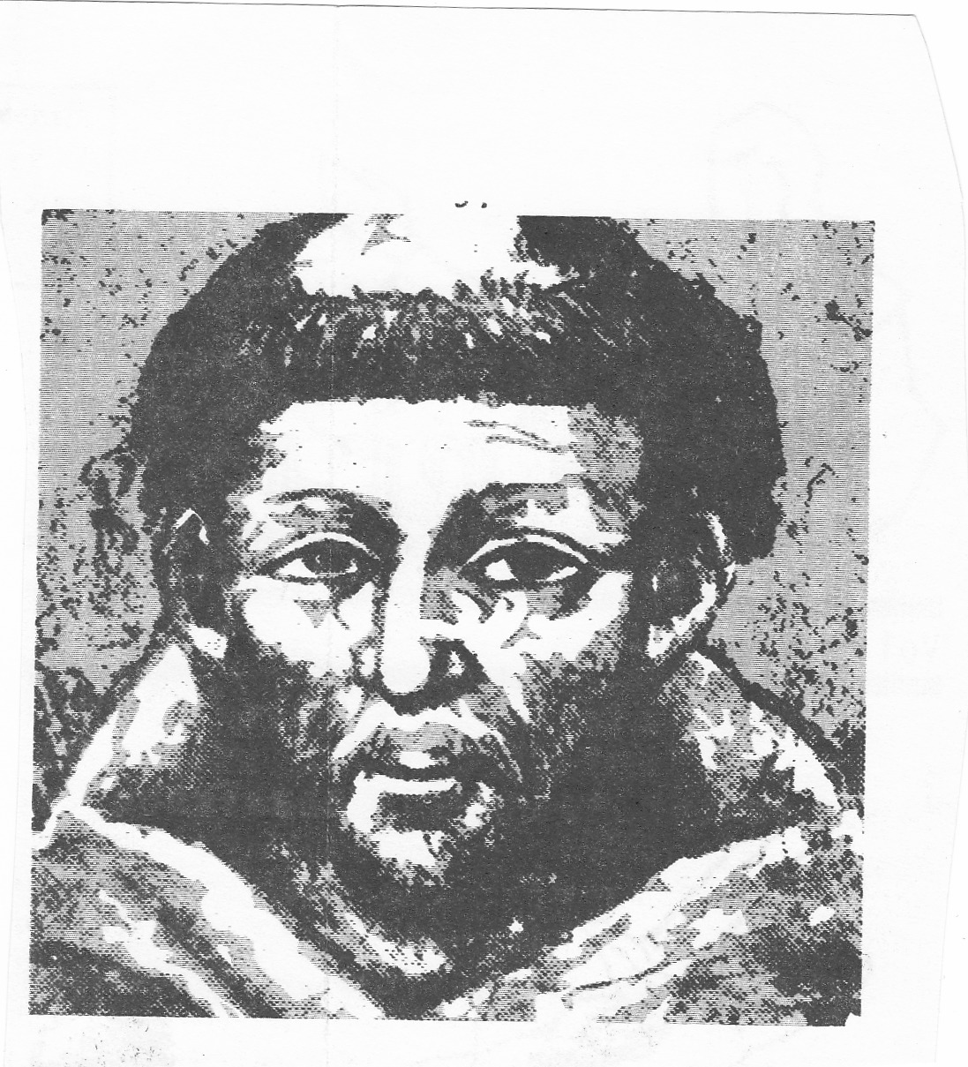
Franciscan Peacemaking
Why do you think this prayer has become so identified with Francis?

Slide 29
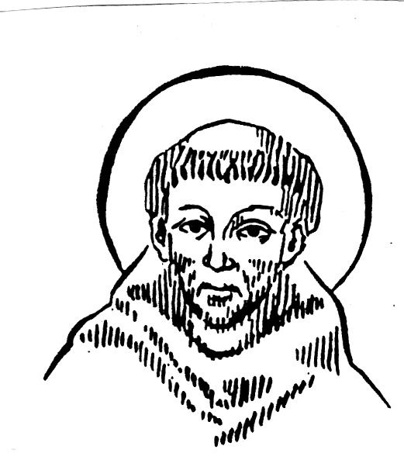
Franciscan Peacemaking
Even though not composed by Francis, The Peace Prayer expresses the desire to be a peacemaker and reconciler in a wounded and broken world that is torn by anger, violence and despair. This prayer reflects the Franciscan spirit and approach to peacemaking.
Notes:
The Peace Prayer’s first appearance was in 1912. It was published in a small French magazine called La Clochette. In 1915 this French prayer was sent to Pope Benedict XV. It was published in the Vatican newspaper, L’Osservatore Romano, in January 1916 as a prayer for the end of World War I. Around 1920 a French Franciscan printed the prayer on the back of an image of St. Francis, but he did not attribute the prayer to St. Francis. In 1936, Kirby Page, a Disciple of Christ minister, attributed the prayer to St. Francis; yet it remains a mystery how the prayer became associated with St. Francis. Nevertheless, this prayer encapsulates who St. Francis was and whom Jesus calls us to be.

